Slide 1
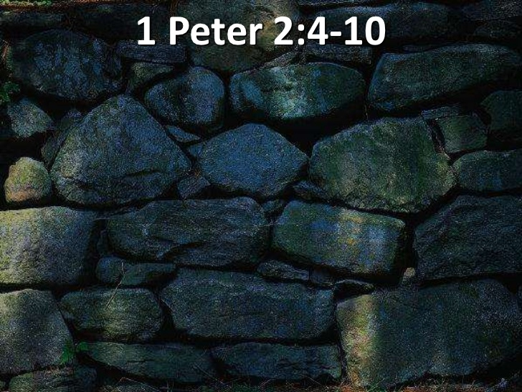
THE DECREE: 2024 5784-5785
MIRACLE CITY GLOBAL: BUILT BY GOD…

Slide 4
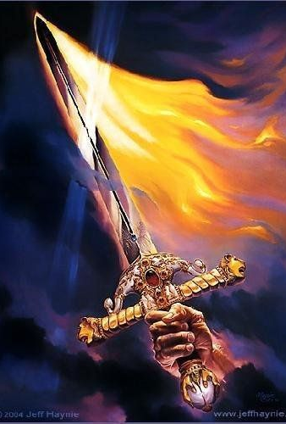
THE WORD OF GOD
PROCEEDING WORD
THE LOGOS
THE RHEMA
PROPHECY
THE DECREE

Slide 7
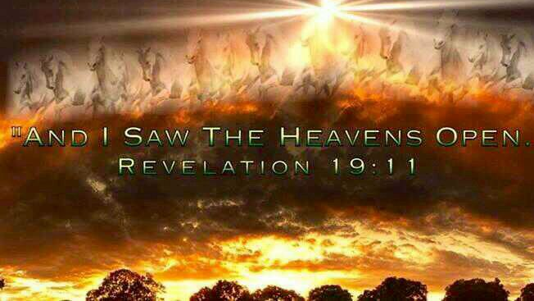
Revelation 19:11-16
I saw heaven standing open and there before me was a white horse, whose rider is called Faithful and True. With justice He judges and makes war. 12 His eyes are like blazing fire, and on His head are many crowns. He has a name written on him that no one knows but he himself. 13 He is dressed in a robe dipped in blood, and his name is the Word of God. 14 The armies of heaven were following him, riding on white horses and dressed in fine linen, white and clean. 15 Out of his mouth comes a sharp sword with which to strike down the nations. "He will rule them with an iron scepter." He treads the winepress of the fury of the wrath of God Almighty. 16 On his robe and on his thigh he has this name written: KING OF KINGS AND LORD OF LORDS. NIV

Slide 8
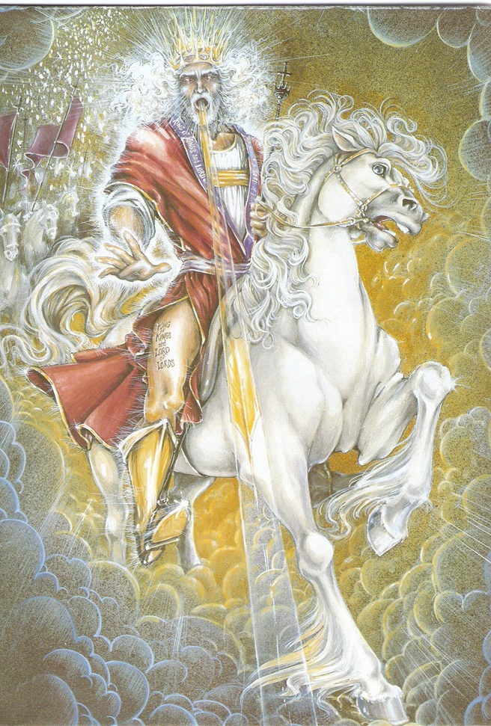
JESUS CHRIST THE WORD OF GOD
REVELATION 19:13
He is dressed in a robe dipped in blood, and his name is the Word of God.

Slide 13
YOU WILL FRAME YOUR DAY BY WHAT YOU SAY!
FRAME BY FRAME

Slide 14
THE WORD OF GOD
PROCEEDING WORD
THE LOGOS
THE RHEMA
PROPHECY
THE DECREE

Slide 15
THE PROCEEDING WORD…
Matthew 4:4 But He answered and said, "It is written, 'Man shall not live by bread alone, but by every word that proceeds from the mouth of God.'" NKJV

Slide 16
THE PROCEEDING WORD OF GOD
Heb 11:1-3 Now faith is the substance of things hoped for, the evidence of things not seen. 2 For by it the elders obtained a good report. 3 Through faith we understand that the worlds were framed by the word of God, so that things which are seen were not made of things which do appear. KJV
Isa 55:11 so is my word that goes out from my mouth — it will not return to me unfulfilled; but it will accomplish what I intend, and cause to succeed what I sent it to do. CJB
Isa 55:11 So shall My word be that goes forth from My mouth; It shall not return to Me void, But it shall accomplish what I please, And it shall prosper in the thing for which I sent it. NKJV

Slide 17
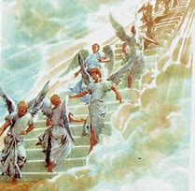
ANGELS RUN…
Psalm 103:20 Bless Adonai, you angels of His, you mighty warriors who obey his word, who carry out his orders! CJB

Slide 20
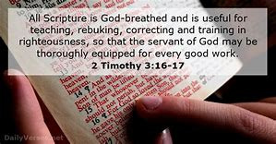
THE LOGOS
THE WRITTEN WORD OF GOD
2 Tim 3:16-17 All Scripture is God-breathed and is useful for teaching, rebuking, correcting and training in righteousness, 17 so that the man of God may be thoroughly equipped for every good work. NIV

Slide 21
THE RHEMA…
Strong's Concordance (#G4487) Rhema means an utterance (individually, collectively or specifically) on a particular matter or topic.
Thayer's Greek Lexicon Rhema: Something that has been uttered, in either the past or the present, by a living entity. The first time Rhema is used in the New Testament is during Jesus' forty-day temptation by Satan. Jesus, after being tempted to feed himself through a miracle after fasting for a long period, responds with the following.

Slide 22
THE RHEMA…
John 15:7-8 If you remain in me and my words remain in you, ask whatever you wish, and it will be given you. 8 This is to my Father's glory, that you bear much fruit, showing yourselves to be my disciples. NIV

Slide 23
2 Peter 1:21 For prophecy never had its origin in the will of man, but men spoke from God as they were carried along by the Holy Spirit. NIV

Slide 24
PROPHECY…
Prophecy: (prophetetia) (Pro, “for/forth” ; phemi, “to speak”)
The speaking forth of the heart, mind and counsel of God.
This word also means to bubble up, to flow forth, or to cause to drop like rain.
It is the declaration of that which cannot be known by natural means.
It is the forth-telling of the will of God, whether with reference to the past, the present, or the future.
It is the Holy Spirit expressing the thoughts and desires of Christ through a human voice.

Slide 25
PROPHECY…
New Testament prophecy functions in three realms:
1. Spirit of Prophecy and Prophetic Song- Jesus giving inspired testimony and praise through one of his saints by prophetic utterance or song of the Lord. (Heb.2:12; Rev. 19:10)
2. The Gift of Prophecy- One of the manifestations of the Holy Spirit which brings strength, encouragement,and comfort to the Body of Christ.(1Cor. 12:10; Rom. 12:6)
3. The Prophet speaking forth by divine utterance the mind and counsels of God and giving rhema word for strengthening, direction, correction, confirmation, and instruction in righteousness.

Slide 26
PROPHECY…
Acts 2:17‑21
17 "'In the last days, God says, I will pour out my Spirit on all people. Your sons and daughters will prophesy, your young men will see visions, your old men will dream dreams. 18 Even on my servants, both men and women, I will pour out my Spirit in those days, and they will prophesy. 19 I will show wonders in the heaven above and signs on the earth below, blood and fire and billows of smoke. 20 The sun will be turned to darkness and the moon to blood before the coming of the great and glorious day of the Lord. 21 And everyone who calls on the name of the Lord will be saved.'

Slide 27
WAGING WAR FIGHT THE GOOD FIGHT
1 Timothy 1: 18-19
Timothy, my son, I give you this instruction in keeping with the prophecies once made about you, so that by following them you may fight the good fight, 19 holding on to faith and a good conscience. Some have rejected these and so have shipwrecked their faith. NIV
1 Cor 14:1-4
14:1 Follow the way of love and eagerly desire spiritual gifts, especially the gift of prophecy. 2 For anyone who speaks in a tongue does not speak to men but to God. Indeed, no one understands him; he utters mysteries with his spirit. 3 But everyone who prophesies speaks to men for their strengthening, encouragement and comfort. 4 He who speaks in a tongue edifies himself, but he who prophesies edifies the church.

Slide 28
THE AGES ARE CONVERGING AND NOW PROPHETIC WORDS THAT ARE INFUSED WITH God assignments are intersecting their moment.
tim sheets

Slide 30
THE DECREE: The predetermined purpose of God; the purpose or determination of an immutable Being, whose plan of operations is, like himself, unchangeable

Slide 31
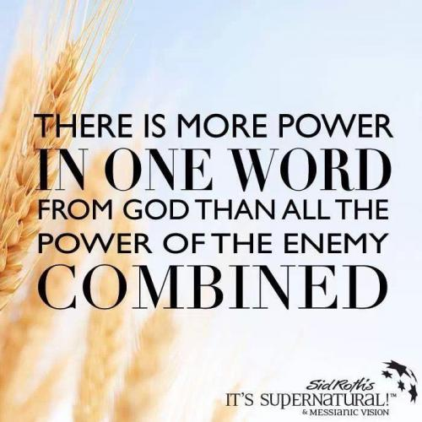
THE DECREE…
GAZAR — to cut, to divide, to cut down, to cut off, to cut in two, to snatch, to decree

Slide 32
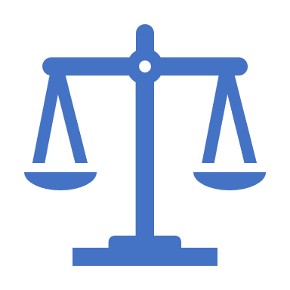
DECREE: To judge; to divide.
1. Judicial decision, or determination of a litigated cause; as a decree of the court of chancery. The decision of a court of equity is called a decree; that of a court of law, a judgment.
2. In the civil law, a determination or judgment of the emperor on a suit between parties.
3. An edict or law made by a council for regulating any business within their jurisdiction; as the decrees of ecclesiastical councils.

Slide 33
DECREE: To judge; to divide.
4. In general, an order, edict or law made by a superior as a rule to govern inferiors.
There went a decree from Cesar Augustus, that all the world should be taxed. Luke 2.
5. Established law, or rule.
He made a decree for the rain. Job 20:28.
6. In theology, predetermined purpose of God; the purpose or determination of an immutable Being, whose plan of operations is, like himself, unchangeable.

Slide 34
Psalm 2:7-8 I will proclaim the decree of the Lord: He said to me, "You are my Son; today I have become your Father. 8 Ask of me, and I will make the nations your inheritance, the ends of the earth your possession.
Proverbs 8:15-16 By me kings reign, and princes decree justice. By me princes rule, and nobles, even all the judges of the earth.

Slide 35
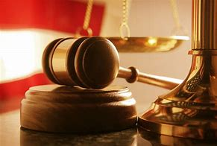
DECREE:
1. To determine judicially; to resolve by sentence; as, the court decreed that the property should be restored; or they decreed a restoration of the property.
2. To determine or resolve legislatively; to fix or appoint; to set or constitute by edict or in purpose.
Thou shalt decree a thing, and it shall be established. Job 22:28

Slide 36
CREATE IT! Psalm 104:30 When you send your Spirit, they are created, and you renew the face of the earth.

Slide 37
CREATE IT!

Slide 38
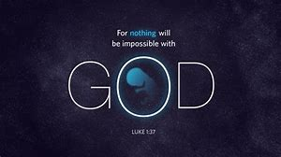
CREATE IT!
LUKE 1:37
FOR NO WORD SPOKEN BY GOD GOD IS WITHOUT POWER.

Slide 39
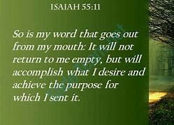
CREATE IT…
HOLY SPIRIT HOVERS…
HEAVEN RUNS…
YOUR KINGDOM COME…
YOUR WILL BE DONE…

Slide 41
ISAIAH 55:11 So will the words that come out of my mouth not come back empty-handed. They'll do the work I sent them to do, they'll complete the assignment I gave them.

Slide 42
CREATE IT...

Slide 43
Matthew 28:18‑20 Then Jesus came to them and said, “All authority in heaven and on earth has been given to me. 19 Therefore go and make disciples of all nations, baptizing them in the name of the Father and of the Son and of the Holy Spirit, 20 and teaching them to obey everything I have commanded you. And surely I am with you always, to the very end of the age."

Slide 44
Luke 10:19 I have given you authority to trample on snakes and scorpions and to overcome all the power of the enemy; nothing will harm you.

Slide 45
EXOUSIA: AUTHORITY, JURISDICTION, LIBERTY, POWER, RIGHT, STRENGTH.

Slide 46
CREATE IT…

Slide 47
ABSOLUTE AUTHORITY AUTHORITY WORKS SMART AUTHORITY HAS SENORITY AUTHORITY SPEAKS AUTHORITY SAYS

Slide 48
Mark 11:23-25 "I tell you the truth, if anyone says to this mountain, 'Go, throw yourself into the sea,' and does not doubt in his heart but believes that what he says will happen, it will be done for him. 24 Therefore I tell you, whatever you ask for in prayer, believe that you have received it, and it will be yours. 25 And when you stand praying, if you hold anything against anyone, forgive him, so that your Father in heaven may forgive you your sins."

