Slide 1
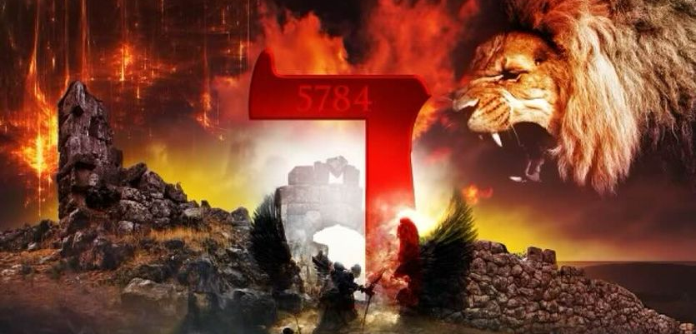
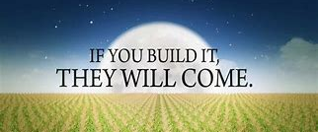
THE DECREE: 5784
NOW UNTO HIM WHO IS ABLE TO DO....

Slide 2
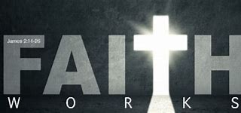

Slide 3
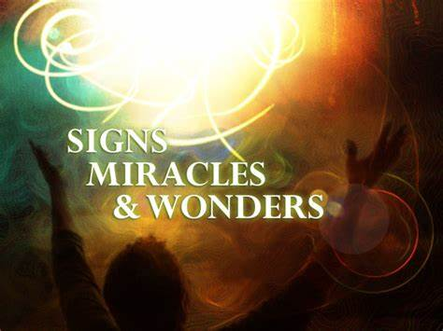
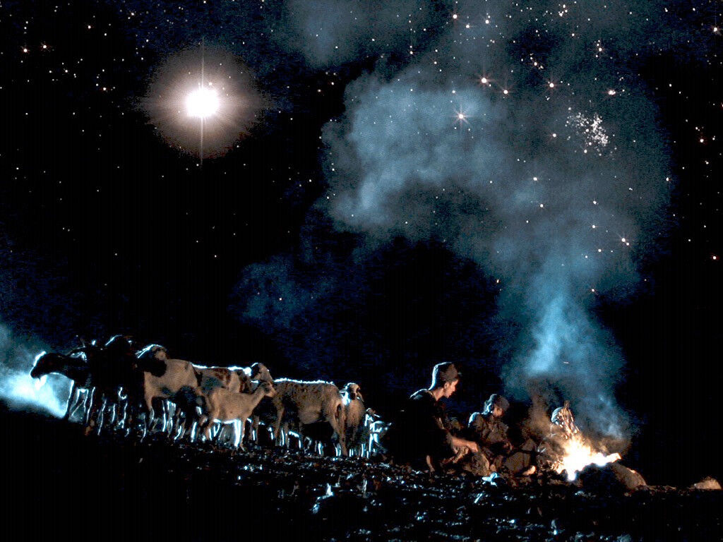
MIRACLES! MIRACLES! MIRACLES!
MIRACLE MANIFESTATIONS ARE UPON – ENTER THE DOOR TO THE MIRACULOUS!

Slide 4
THE SEASON OF MIRACLES! MIRACLES! MIRACLES!
"...LET'S GO! LET'S HURRY AND FIND THIS WORD WHO IS BORN IN BETHLEHEM AND SEE FOR OURSELVES WHAT THE LORD HAS REVEALED TO US" Luke 2:15TPT

Slide 5
LET'S GO! LET'S HURRY AND FIND THIS RHEMA...

Slide 6
O Come Let Us Adore Him!
"Your Towdah will become God's Ta-da! To My Body, My Bride, My Functioning Ekklesia! Let's Finish This! I will restore your land from captivity and bring you into the fullness of My Covenant Promises! The Promise of My Word will manifest in your life and in your land! Hold Fast! The “MOREOVER” is upon My People! Give Thanks To the Lord Almighty, He is Good and His Love Endures Forever! "You keep every promise you’ve ever made to me! Since your love for me is constant and endless, I ask you, Lord, to finish every good thing that you’ve begun in me! (Psalms 138:8)

Slide 7
“WE GIVE THANKS TO THE LORD FOR HIS LOVE ENDURES FOREVER! Yes, (OUR) God is more than ready to overwhelm you with every form of grace, so that you will have more than enough of everything— every moment and in every way. He will make you overflow with abundance in every good thing you do. (2 Corinthians 9:8) I Praise You in Advance For the Indescribable, Extravagant, Generous Gift That You Are! I Praise You, Father, For the Abundance of Gifts that You have Given, and Give and Continue To Give - Harvest Here! (12/20/23; BLove)
“Your moreover is here! It is the exceedingly, abundantly! I AM, the above and beyond! I AM your golden ticket!” (4,Tevet 5784, 12/16/23, BLove)

Slide 8
What is Towdah:
“Enter His gates with thanksgiving (towdah), and His courts with praise (tehillah). Give thanks (Yadah) to Him; bless His name. For the LORD is good; His loving kindness is everlasting, And His faithfulness to all generations.” (Psalm 100:4 NASB)
(Psa 50:23 NASB) "He who offers a sacrifice of thanksgiving (towdah) honours Me; And to him who orders his way aright I shall show the salvation of God."

Slide 9
Hebrew words for Praise: Yadah and Towdah
Yadah is a Hebrew word and is listed in the Strong’s Concordance as follows: Yadah (3034). To throw, cast. To cast a stone or arrow. Used in confession, praise and giving thanks.
Yadah is defined as: To give thanks, laud or praise. An expression of thank or praise in ritual, public and personal praise. It is found mostly in the book of psalms, some 70 times.
Yadah comes from the root YAD meaning hand. Yadah then is to throw out the hands, or extend the hands in the giving of thanks as part of our worship experience.

Slide 10
Yadah praise is one in which we raise our hands in an outburst of spontaneous gratitude for what God has done. Our hands are used as an extension of our expression of thanks. One may also express thankful praise on a musical instrument.
Yadah honors and acknowledges Gods hand and purpose over our lives and may be expressed vocally and with musical instruments. Our bodies become an extension of the expression of our hearts.

Slide 11
Yadah is surrender to the Lord, yielding to Him with hands extended. To lift your hands unto the Lord. It carries the meaning of absolute surrender as a young child does to a parent - "pick me up, I'm all yours". Scriptures: Gen. 29:35, 2 Chron. 7:6, 20:21, Psalms 9:1, 28:7, Psalms 33:2, 42:5,11, 49:18, Isaiah 12:1
“And in that day you will say, "Give thanks (yadah) to the LORD, call on His name. Make known His deeds among the peoples; Make them remember that His name is exalted."

Slide 12
TOWDAH
O COME LET US ADORE HIM!
“Your Towdah will become God's Ta-da!”

Slide 13
Towdah is a confession of faith that God is supreme and able to do all things.
Towdah comes from Yadah and means ‘thanksgiving’. Associated with sacrificing, was used of choirs or processions.
Towdah is used as: confession, hymns of thanksgiving, praise, sacrifice of thanksgiving, thank offering.

Slide 14
This type of offering means we will not consider our circumstances with our natural eyes, but we look only through the eyes of faith at our God our deliverer. Towdah is not to be underestimated as it will move the hand of God upon our lives. It believes God for the impossible and releases the power and wisdom of God on our behalf as we praise (Towdah) Him.

Slide 15
“Enter His gates with thanksgiving (towdah), and His courts with praise (tehillah). Give thanks (Yadah) to Him; bless His name. For the LORD is good; His loving kindness is everlasting, And His faithfulness to all generations.” (Psalm 100:4 NASB)
"He who offers a sacrifice of thanksgiving (towdah) honours Me; And to him who orders his way aright I shall show the salvation of God." (Psa 50:23 NASB)

Slide 16
“He who sacrifices thank offerings (TOWDAH)honors Me, and he prepares the way so that I may show him the salvation of God." (Ps 50:23, NIV)
“Whoso offereth praise glorifieth me: and to him that ordereth his conversation aright will I shew the salvation of God.” (Ps 50:23, KJV)

Slide 17
“Towdah: Hebrew word for praise, to extend the hands, to speak the same thing. Jesus, the word, is our sacrifice. To confess the word is how we give a sacrifice of praise to God. Further, the word is our entrance into the presence of God.

Slide 18
It is written: “I believed; therefore I have spoken.” Since we have that same spirit of faith, we also believe and therefore speak,” (2 Corinthians 4:13, NIV)
“Yet we have the same spirit of faith as he had, who wrote in Scripture, “I BELIEVED, THEREFORE I SPOKE.” We also believe, therefore we also speak,” (2 Corinthians 4:13, AMP)

Slide 19
Hebrews 11:1
AMP “Now faith is the assurance (title deed, confirmation) of things hoped for (divinely guaranteed), and the evidence of things not seen [the conviction of their reality—faith comprehends as fact what cannot be experienced by the physical senses].”
TPT “Now faith brings our hopes into reality and becomes the foundation needed to acquire the things we long for. It is all the evidence required to prove what is still unseen.”

Slide 20
Jeremiah 32:37-41
37 I will surely gather them from all the lands where I banish them in my furious anger and great wrath; I will bring them back to this place and let them live in safety.
38 They will be my people, and I will be their God.
39 I will give them singleness of heart and action, so that they will always fear me for their own good and the good of their children after them.
40 I will make an everlasting covenant with them: I will never stop doing good to them, and I will inspire them to fear me, so that they will never turn away from me. \
41 I will rejoice in doing them good and will assuredly plant them in this land with all my heart and soul.

Slide 21
Jeremiah 32:42-44
42 "This is what the Lord says: As I have brought all this great calamity on this people, so I will give them all the prosperity I have promised them.
43 Once more fields will be bought in this land of which you say, 'It is a desolate waste, without men or animals, for it has been handed over to the Babylonians.’
44 Fields will be bought for silver, and deeds will be signed, sealed and witnessed in the territory of Benjamin, in the villages around Jerusalem, in the towns of Judah and in the towns of the hill country, of the western foothills and of the Negev, because I will restore their fortunes, declares the Lord." NIV

Slide 22
