Slide 1
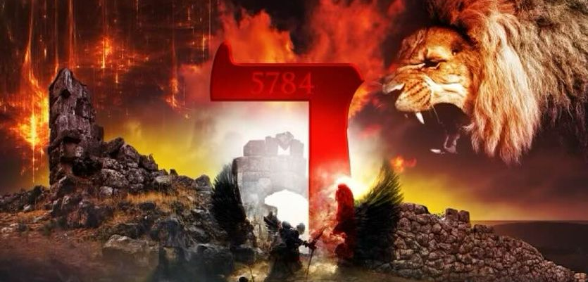
THE DECREE: 5784
NOW UNTO HIM WHO IS ABLE TO DO....

Slide 2
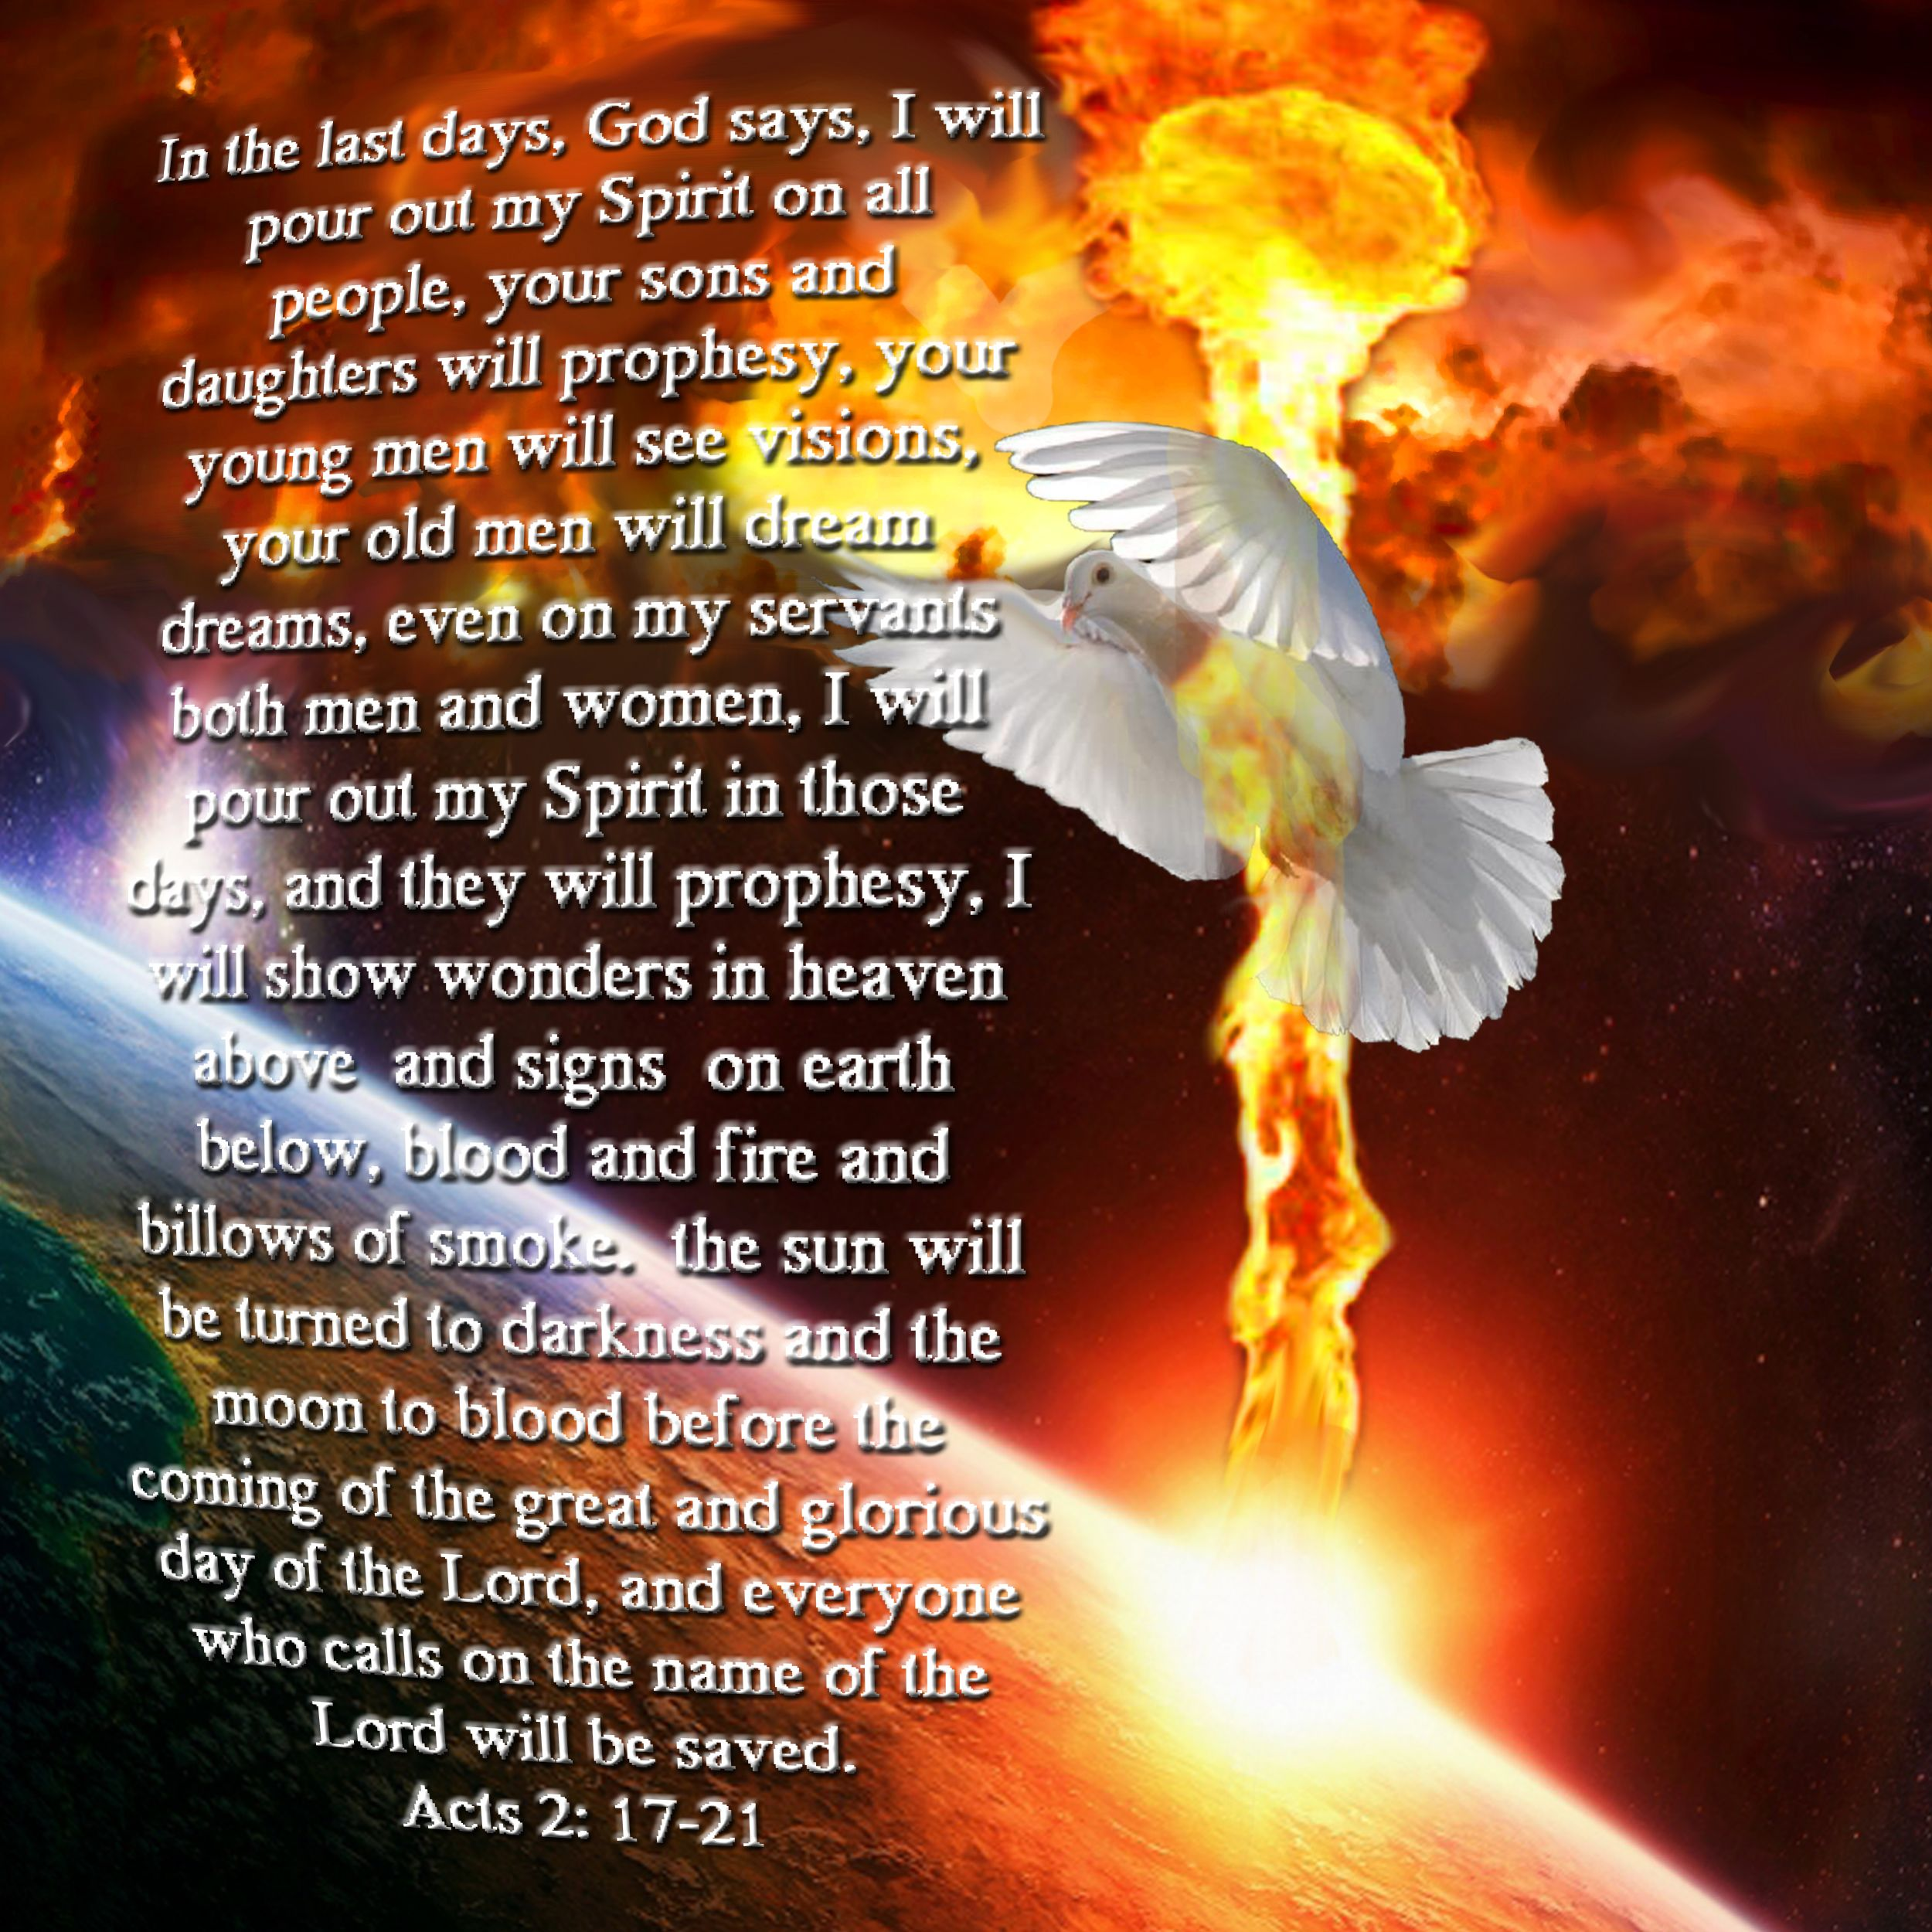
THE MONTH OF VISIONS AND DREAMS

Slide 3
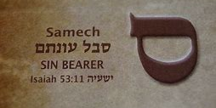
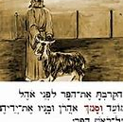
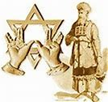
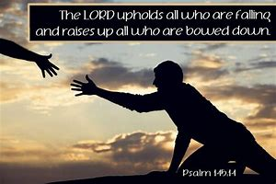
SAMEKH
TRUST
SUPPORT
COMING FULL CIRCLE

