Slide 1
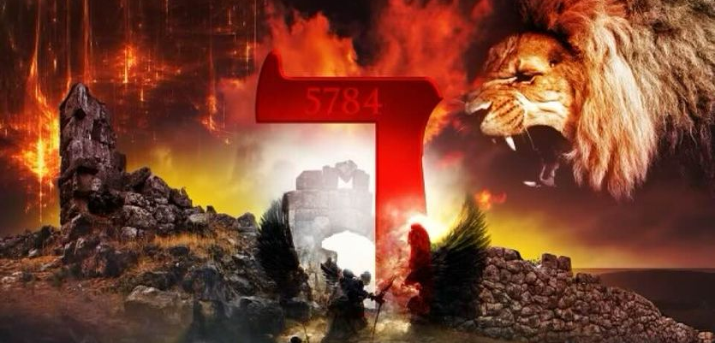
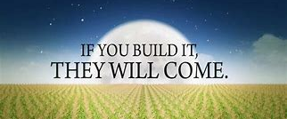
THE DECREE: 5784
NOW UNTO HIM WHO IS ABLE TO DO....

Slide 2
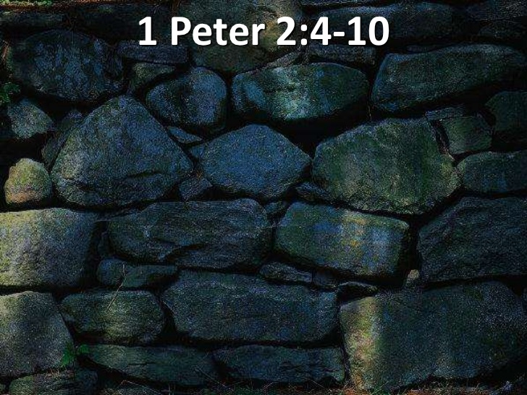
THE DECREE: 5784 2023-2024
MIRACLE CITY GLOBAL: BUILT BY GOD…

Slide 6
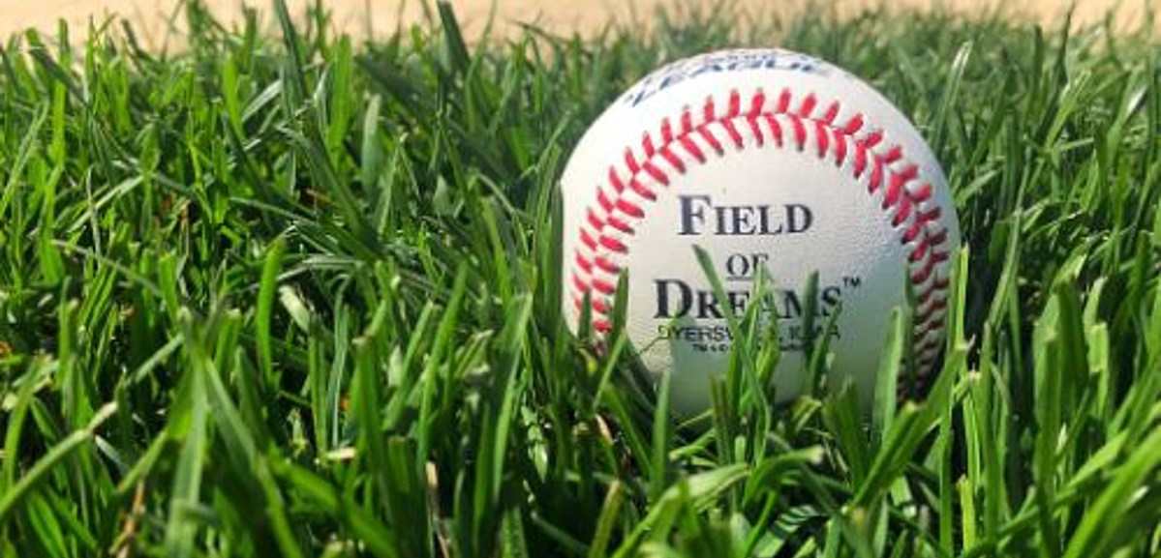

Slide 7
HABITATION
DEUTERONOMY 11:11-12
But the land you are crossing the Jordan to take possession of is a land of mountains and valleys that drinks rain from heaven. It is a land the LORD your God cares for; the eyes of the LORD your God are continually on it from the beginning of the year to its end.

Slide 8
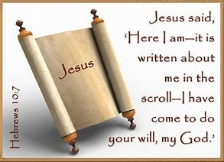
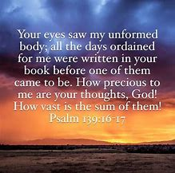
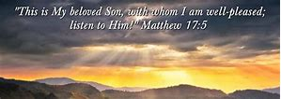
THE GOLDEN BOOKS! I have opened my favorite books in this season - l’m reading and decreeing over My people what is written. My voice comes again- again to say, “This is my son, whom I love, with him I am well pleased!”

Slide 9
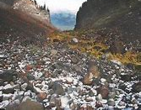
RESTORATION OF YOUR VINEYARDS…
Hosea 2:14-15
"Therefore I am now going to allure her; I will lead her into the desert and speak tenderly to her. 15 There I will give her back her vineyards,and will make the Valley of Achor a door of hope. There she will sing as in the days of her youth, as in the day she came up out of Egypt.

Slide 12
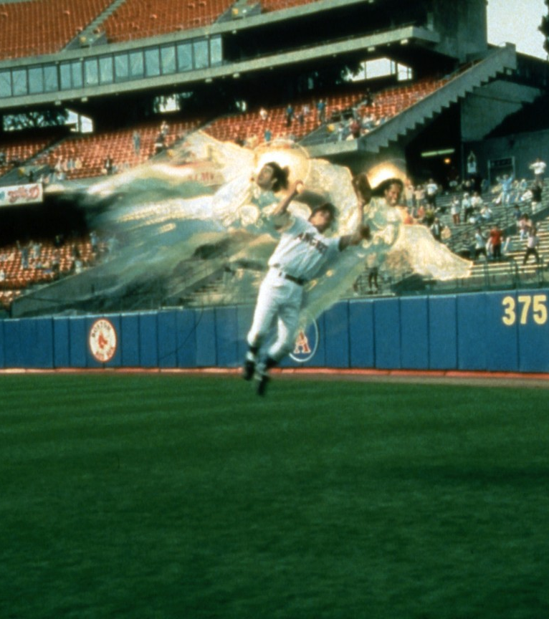

Slide 13
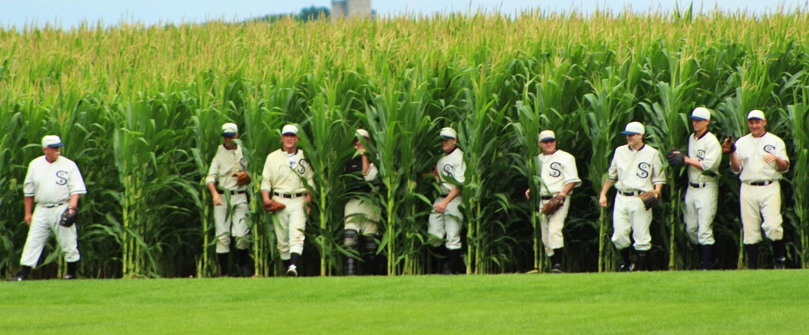
YOU FRAME YOUR DAY BY WHAT YOU SAY!
WHAT KINGDOM ARE YOU SUMMONING?
WHAT KINGDOM ARE YOU BUILDING?
HOW ARE YOUR BUILDING?

