Slide 1
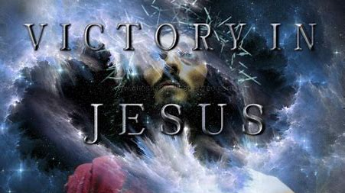

Slide 4
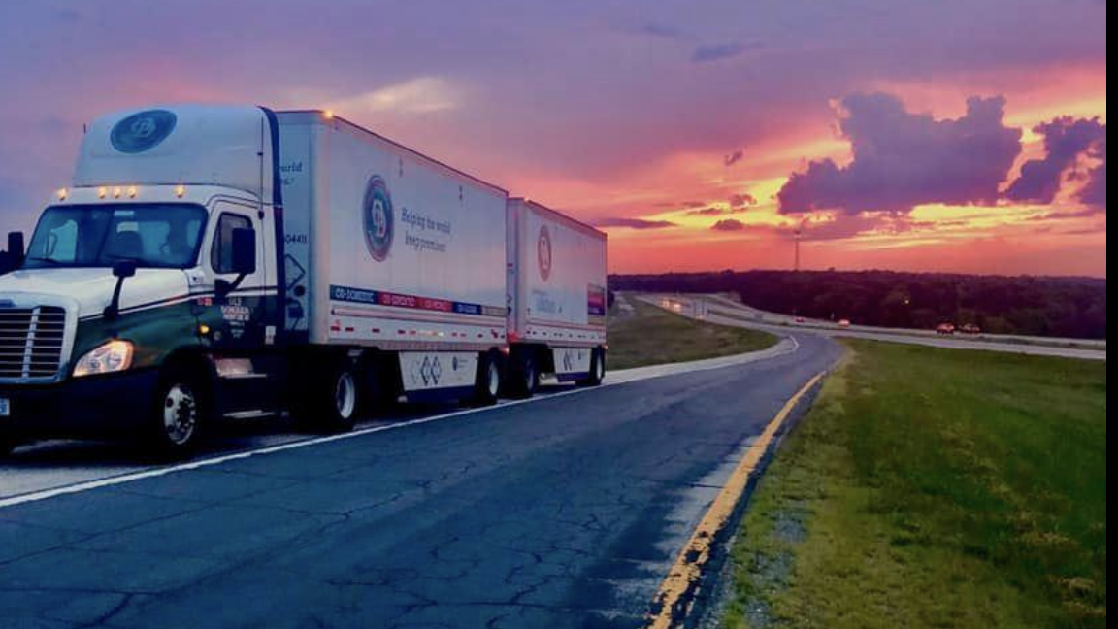

Slide 5
OLD DOMINION
As for you, watchtower of the flock, stronghold of Daughter Zion, the former dominion will be restored to you; kingship will come to Daughter Jerusalem.” MICAH 4:8

Slide 7
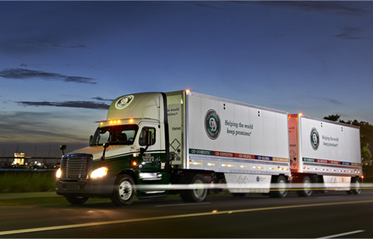
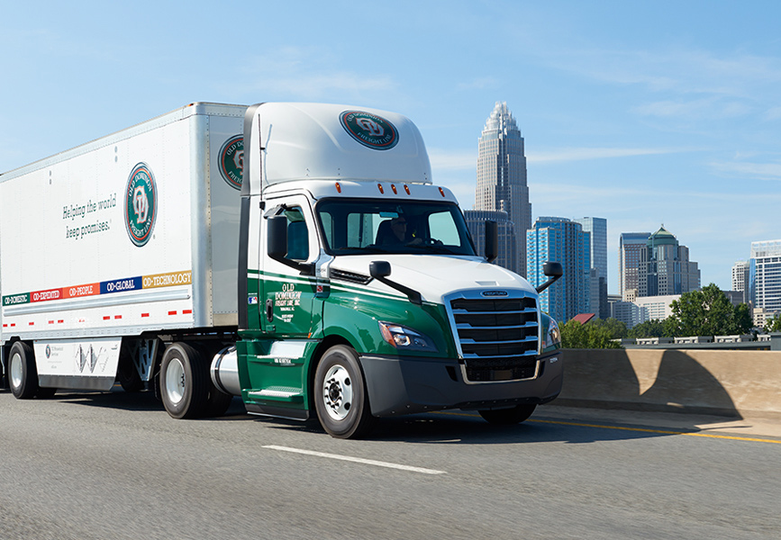

Slide 8
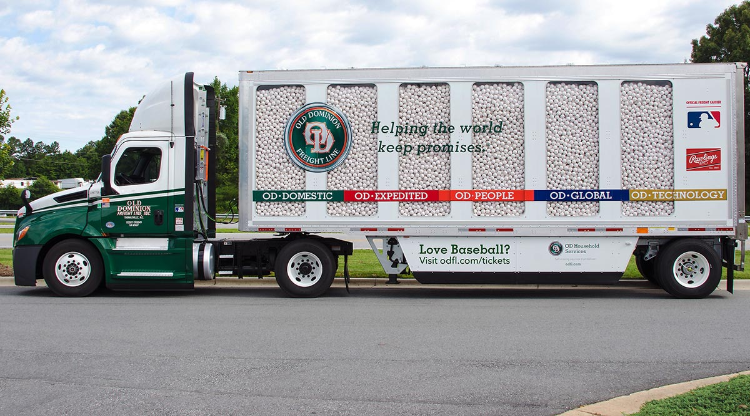
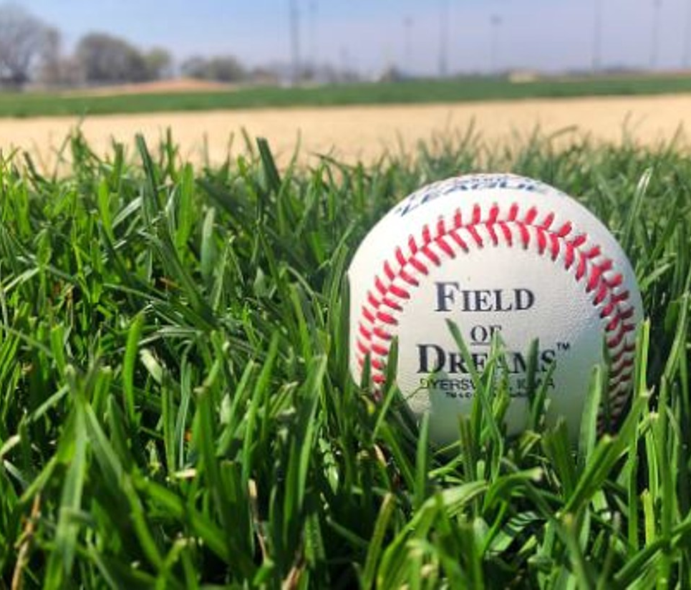
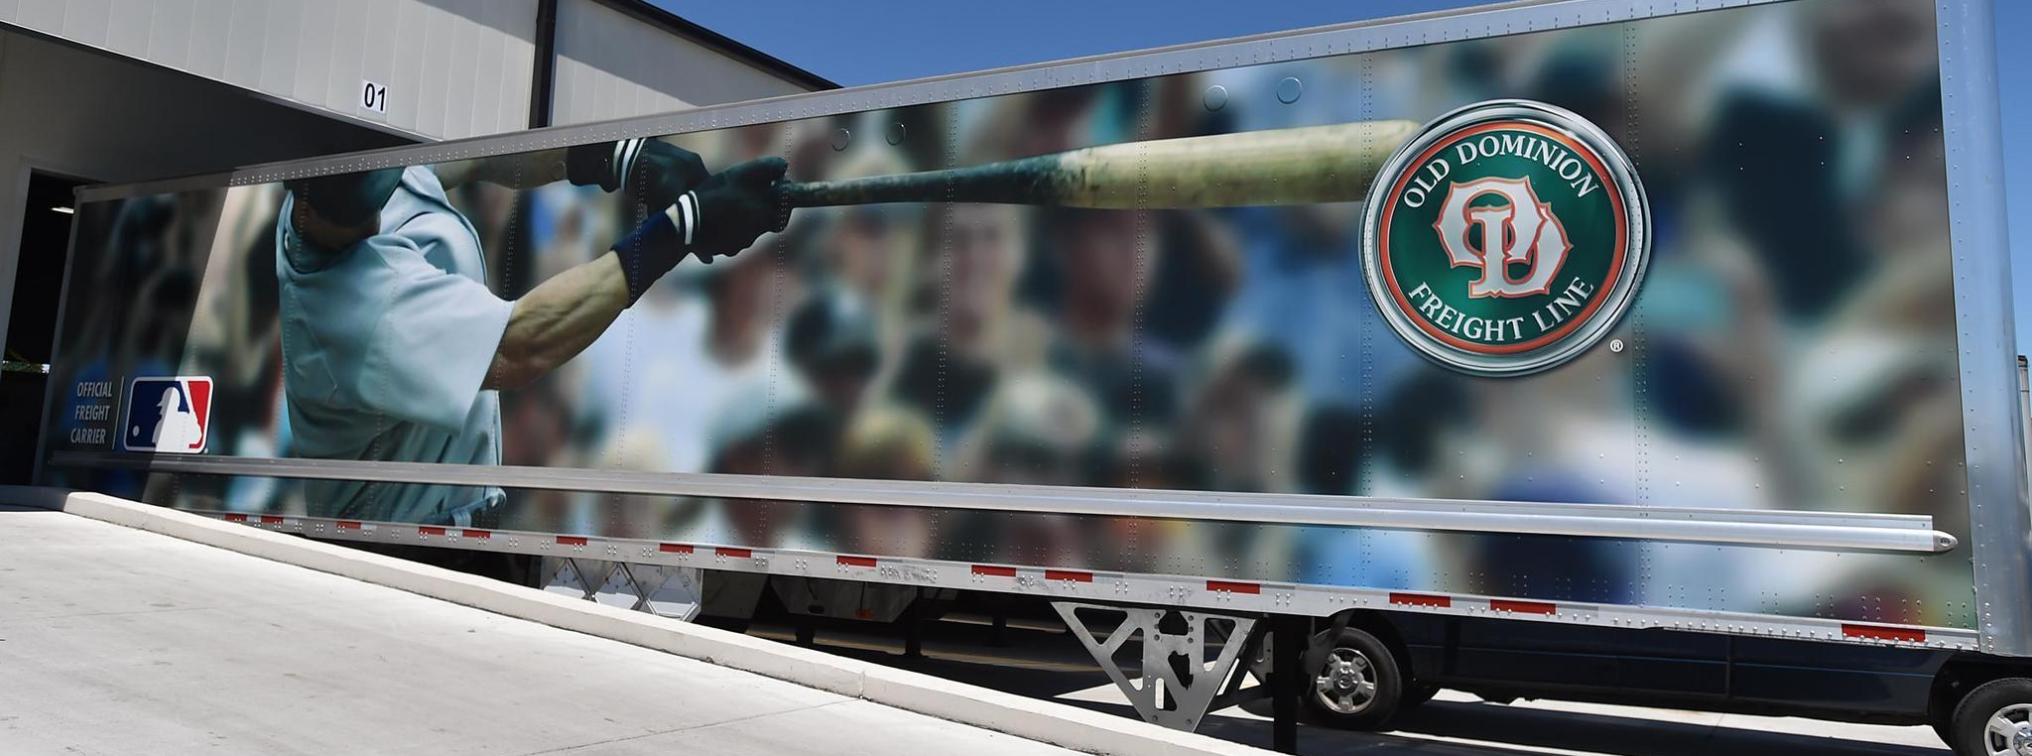
IT IS TIME TO DOMINATE THE FIELD!

Slide 9
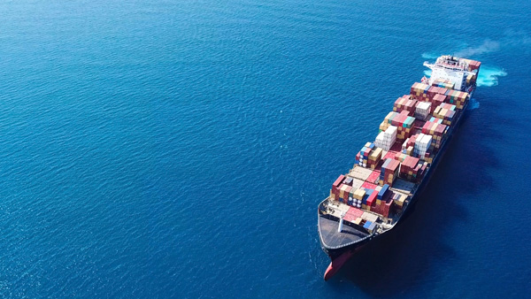
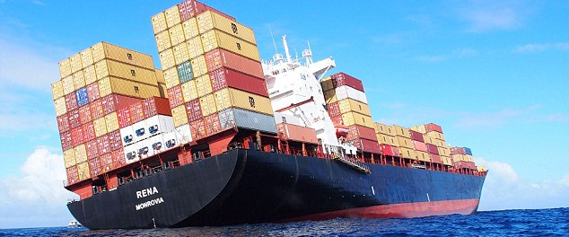
I AM RIGHTING THE SHIP! NOW TURN THIS THING AROUND!

Slide 10
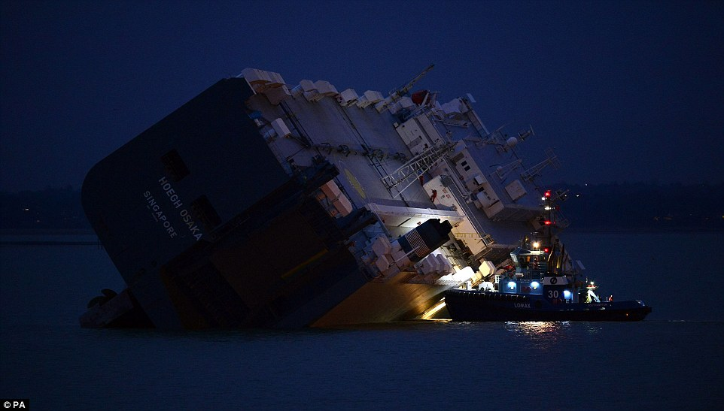
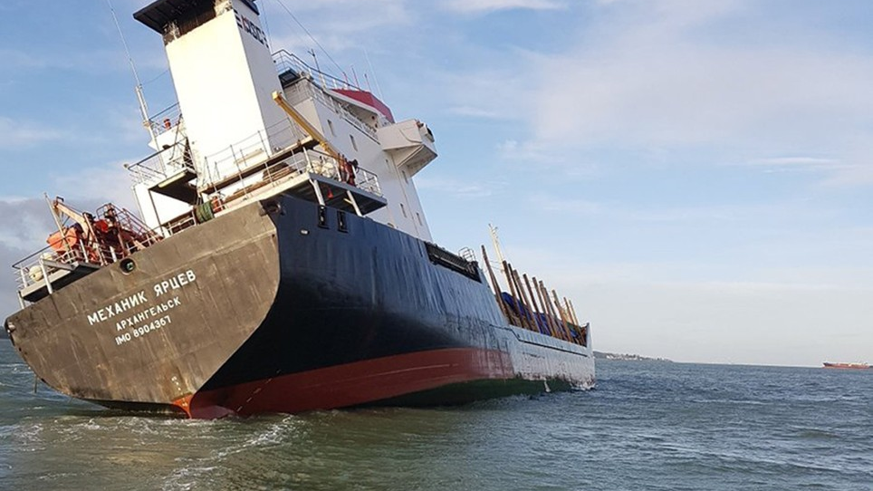
THIS IS YOUR RIGHTING MOMENT

