Slide 1
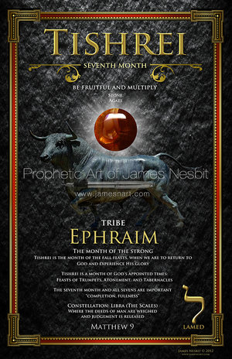

Slide 2
Teshuvah “Repentance”
A time of repentance that is linked to Moses interceding 40 days for Israel (Golden Calf)--Exodus 32
40 days (29 days of Elul {divine grace and mercy}, leading to the Feast of Trumpets {Rosh Hashanah}, and going through and ending on the Day of Atonement {Yom Kippur}
These last 10 days are known as the Days of Awe (Feast of Trumpets to the Day of Atonement)—The gate of heaven is uniquely opened for our petitions and intercession

Slide 3
Tishrei “Beginning”
Begins the autumn season (Tishrei, Cheshvan, and Kislev)
Month of the “strong” or the month of the “ancients”
Tishrei is the 1st month of the year with respect to the reckoning of years
Tishrei is the 7th month of the year with respect to the reckoning of months

Slide 4
Head of the Year
Originally, the Hebrew year started in the month of Tishrei, but when God initiated Passover, He put Israel into a yearly cycle of redemption and commanded that Nissan now be the head of the months.
The first commandment given to them, from God, when they were preparing to leave Egypt was: “This month (the month of Nissan) shall be for you the first of the months”
While the Hebrew years are still numbered from Tishrei (the first of Tishrei is Rosh Hashanah, the head of the year), the months are now numbered from Nissan. That’s why the Jewish “New Year” begins at the start of the seventh month.

Slide 5
Characteristics
The 7th month---Completion and Fullness
The month of the Fall Feasts---Returning to God and Experiencing His Glory
The month to Press Through to touch Him---Matthew 9:18-22
The month linked with awakening and removing that which would keep you from returning
The month to be sure you are cleansed from all BITTERNESS so you won’t be hindered
Things finishing and beginning simultaneously---2 Cor 5:17

Slide 6
Characteristics
Returning to your absolute source
Month of Return, Repentance, and Rejoicing
Experience His mercy and forgiveness
Time to awake from your slumber---Eph 5:14-21
Pray for scattered things to be returned to you
Follow the lead of the Good Shepherd---John 10:1-30
Celebrate the New and Better Covenant---Heb 7-9

Slide 7
Tishrei
Rosh Hashanah(Feast of Trumpets)-(AWAKE) Tishrei 1
Days of Awe-(Reflection and Returning)
Tishrei 1-10
Yom Kippur(Day of Atonement)-(REPENT) Tishrei 10
Succot(Feast of Tabernacles)-(REJOICE) Tishrei 15-21

Slide 8
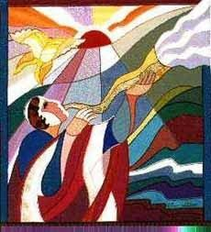
Feast of Trumpets/Rosh Hashanah “The Head of the Year” AWAKE!!!
Leviticus 23:23-27 (a memorial of blowing trumpets…a holy convocation)
Preparation for the Day of Atonement 8 days later
The beginning of the 3rd feast cycle
God is providing revelation for the year ahead, so you can start your beginning in a new way

Slide 9
Day of Atonement/Yom Kippur REPENT!!!
Holiest and most somber day of the Jewish year
This day is marked by fasting and confession
Conclusion of the 10 Days of Awe
Leviticus 16:29-32 and Leviticus 23:26-32

Slide 10
Yom Kippur/Day of Atonement
The word “Kippur” means “Covering”
The High Priest would confess the sins of Israel by laying his hands on the head of a goat. The goat would then “take on” the sin of the nation and be sacrificed. The Lord would then accept the blood offering and extend forgiveness to Israel, thus Israel would be “Covered” for another year.

Slide 11
Psalms 139:23-24 TPT
God, I invite your searching gaze into my heart. Examine me through and through; find out everything that may be hidden within me. Put me to the test and sift through all my anxious cares. See if there is any path of pain I’m walking on, and lead me back to your glorious, everlasting ways---the path that brings me back to you.

Slide 12
What about us, today?
2 Corinthians 5:21
“For God made the only one who did not know sin to become sin for us, so that we who did not know righteousness might become the righteousness of God through our union with him.”

Slide 13
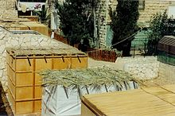
Feast of Tabernacles/Sukkot “The Season of Our Joy” REJOICE!!!
Construction of frail huts or booths (reminds us of God’s provision and our dependence on Him)
Leviticus 23:39-43 and Nehemiah 8:17-18

Slide 14
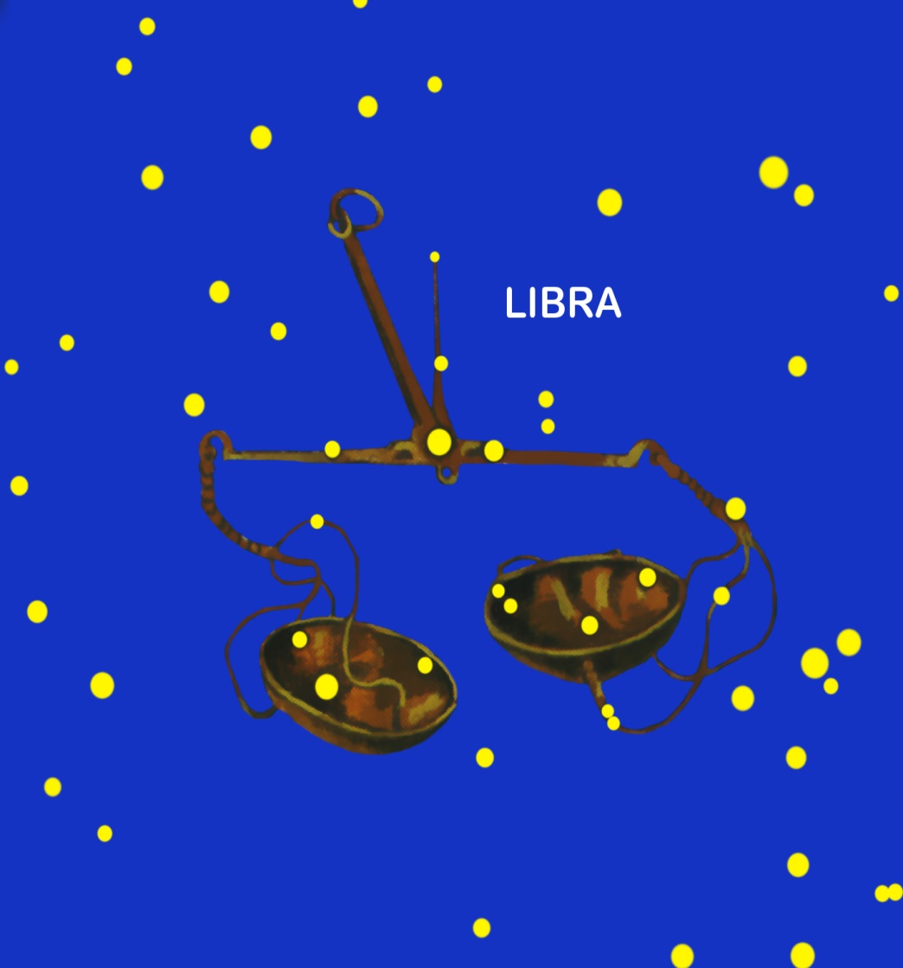
CONSTELLATION LIBRA-THE SCALES
Where the deeds of man are weighed and judgment is released
“The Books” open on Rosh Hashanah and close on Yom Kippur

Slide 15
Reflected Light
Month of “Reflected Light” of the moon
Changes our environment
The way we process time
The way we work
The way crops grow
The way we harvest

Slide 16
Ephraim
Descendants of Ephraim:
Joshua
Samuel
Jeroboam
The city of Shechem was part of Ephraim’s inheritance (Joseph’s bones were buried there and it was also one of the 6 cities of refuge)
Second son of Joseph, but received the blessing of the firstborn (Genesis 48:17-20)
Name means “Double Fruit”
When born, Joseph proclaimed, “God has made me fruitful in the land of my affliction.”

Slide 17
Ephraim
Psalms 60 and 108 (the Lord calls Ephraim “the helmet of His head”
Psalms 78—armed for battle, but turned back in the day of battle
God rejected the tribe of Ephraim and chose Judah to be the rulers
Isaiah 11:10-13 (Prophecy when the Lord will restore them and reunite the nation)
Hosea lists the idolatry, unfaithfulness, and iniquity of Ephraim (described as a silly dove and wild donkey)
Zechariah 9 descibes the Lord using Judah like a bow and Ephraim like an arrow.
Zechariah 10:7—Ephraim is a mighty man who rejoices in the Lord

Slide 18
Alphabet (LAMED)
12th letter of the Hebrew Alphabet
Numerical value of 30
Perfection and Divine Order
The aspiration to return to your absolute source (ask the Lord how you are to get, to the place, where you are sure you are flowing in what He is doing)
Decree that the things that have been scattered will be returned to you
A Shepherd’s Staff, To Teach, Point, Goad, Prod Toward

Slide 19
Action-Touch Matt 9:20-22

Slide 20
Body Part-Galbladder
The gallbladder is a pear-shaped, hollow structure located under the liver and on the right side of the abdomen. Its primary function is to store and concentrate bile, a yellow-brown digestive enzyme produced by the liver. The gallbladder is part of the biliary tract.

Slide 21
Color/Stone Black//Black Onyx or Agate

