Slide 1
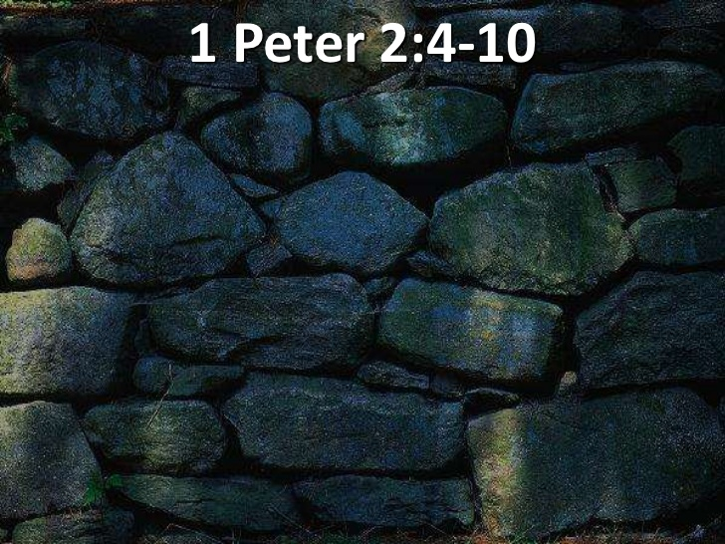
THE DECREE: 5784 2023-2024
MIRACLE CITY GLOBAL: BUILT BY GOD…

Slide 4
FRAMED
FRAME BY FRAME

Slide 5
YOU WILL FRAME YOUR DAY BY WHAT YOU SAY!
FRAME BY FRAME

Slide 8
IN THE BEGINNING…
John 1:1-3 In the beginning was the Word, and the Word was with God, and the Word was God. 2 He was with God in the beginning. 3 Through him all things were made; without Him nothing was made that has been made. NIV

Slide 9
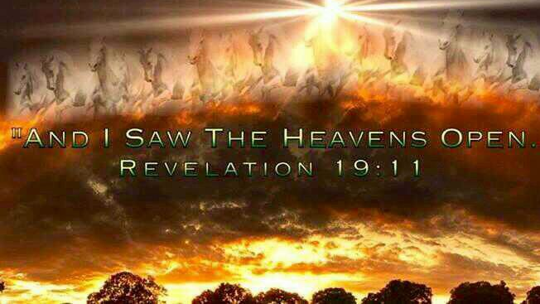
Revelation 19:11-16
I saw heaven standing open and there before me was a white horse, whose rider is called Faithful and True. With justice He judges and makes war. 12 His eyes are like blazing fire, and on His head are many crowns. He has a name written on him that no one knows but he himself. 13 He is dressed in a robe dipped in blood, and his name is the Word of God. 14 The armies of heaven were following him, riding on white horses and dressed in fine linen, white and clean. 15 Out of his mouth comes a sharp sword with which to strike down the nations. "He will rule them with an iron scepter." He treads the winepress of the fury of the wrath of God Almighty. 16 On his robe and on his thigh he has this name written: KING OF KINGS AND LORD OF LORDS. NIV

Slide 10
HEBREWS 11:3
By faith [that is, with an inherent trust and enduring confidence in the power, wisdom and goodness of God] we understand that the worlds (universe, ages) were framed and created [formed, put in order, and equipped for their intended purpose] by the word of God, so that what is seen was not made out of things which are visible.

Slide 11
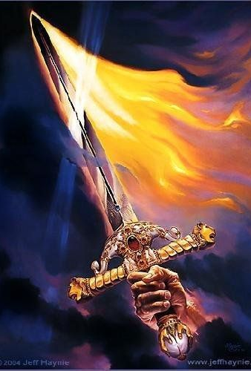
THE WORD OF GOD
PROCEEDING WORD
THE LOGOS
THE RHEMA
PROPHECY
THE DECREE

Slide 13
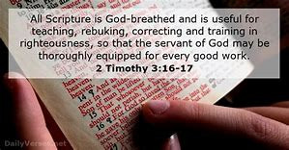
THE LOGOS
THE WRITTEN WORD OF GOD
2 Tim 3:16-17 All Scripture is God-breathed and is useful for teaching, rebuking, correcting and training in righteousness, 17 so that the man of God may be thoroughly equipped for every good work. NIV

Slide 14
THE RHEMA…
Strong's Concordance (#G4487) Rhema means an utterance (individually, collectively or specifically) on a particular matter or topic.
Thayer's Greek Lexicon Rhema: Something that has been uttered, in either the past or the present, by a living entity. The first time Rhema is used in the New Testament is during Jesus' forty-day temptation by Satan. Jesus, after being tempted to feed himself through a miracle after fasting for a long period, responds with the following.

Slide 15
THE RHEMA…
John 15:7-8 If you remain in me and my words remain in you, ask whatever you wish, and it will be given you. 8 This is to my Father's glory, that you bear much fruit, showing yourselves to be my disciples. NIV

Slide 16
IT IS TIME FOR THE IT IS WRITTEN’S

Slide 17
THE PROCEEDING WORD…
Matthew 4:4 But He answered and said, "It is written, 'Man shall not live by bread alone, but by every word that proceeds from the mouth of God.'" NKJV

Slide 18
THE PROCEEDING WORD OF GOD
Heb 11:1-3 Now faith is the substance of things hoped for, the evidence of things not seen. 2 For by it the elders obtained a good report. 3 Through faith we understand that the worlds were framed by the word of God, so that things which are seen were not made of things which do appear. KJV
Isa 55:11 so is my word that goes out from my mouth — it will not return to me unfulfilled; but it will accomplish what I intend, and cause to succeed what I sent it to do. CJB
Isa 55:11 So shall My word be that goes forth from My mouth; It shall not return to Me void, But it shall accomplish what I please, And it shall prosper in the thing for which I sent it. NKJV

Slide 19
ISAIAH 55:8-11
“I don’t think the way you think. The way you work isn’t the way I work.” God’s Decree. “For as the sky soars high above earth, so the way I work surpasses the way you work, and the way I think is beyond the way you think. Just as rain and snow descend from the skies and don’t go back until they’ve watered the earth, Doing their work of making things grow and blossom, producing seed for farmers and food for the hungry, So will the words that come out of my mouth not come back empty-handed. They’ll do the work I sent them to do, they’ll complete the assignment I gave them.

Slide 21
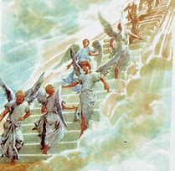
ANGELS RUN…
Psalm 103:20 Bless Adonai, you angels of His, you mighty warriors who obey his word, who carry out his orders! CJB

Slide 22
2 Peter 1:21 For prophecy never had its origin in the will of man, but men spoke from God as they were carried along by the Holy Spirit. NIV

Slide 23
PROPHECY…
Prophecy: (prophetetia) (Pro, “for/forth” ; phemi, “to speak”)
The speaking forth of the heart, mind and counsel of God.
This word also means to bubble up, to flow forth, or to cause to drop like rain.
It is the declaration of that which cannot be known by natural means.
It is the forth-telling of the will of God, whether with reference to the past, the present, or the future.
It is the Holy Spirit expressing the thoughts and desires of Christ through a human voice.

Slide 24
PROPHECY…
Acts 2:17‑21
17 "'In the last days, God says, I will pour out my Spirit on all people. Your sons and daughters will prophesy, your young men will see visions, your old men will dream dreams. 18 Even on my servants, both men and women, I will pour out my Spirit in those days, and they will prophesy. 19 I will show wonders in the heaven above and signs on the earth below, blood and fire and billows of smoke. 20 The sun will be turned to darkness and the moon to blood before the coming of the great and glorious day of the Lord. 21 And everyone who calls on the name of the Lord will be saved.'

Slide 25
THE AGES ARE CONVERGING AND NOW PROPHETIC WORDS THAT ARE INFUSED WITH God assignments are intersecting their moment.
tim sheets

Slide 26
IT IS TIME FOR THE IT IS WRITTEN’S

Slide 27
HEAR IT! SEE IT! SAY IT!

Slide 28
2 CORINTHIANS 4:13
It is written: “I believed; therefore I have spoken. “With that same spirit of faith we also believe and therefore speak. NIV

Slide 30
BEFORE TIME…

Slide 31
YOU COVERED ME

Slide 32
FRAMED
FRAME BY FRAME

Slide 33
LOOK TO SEE…

Slide 34
FRAME THE DAY!

Slide 35
GOD HAS YOUR LAYOUT!

Slide 37
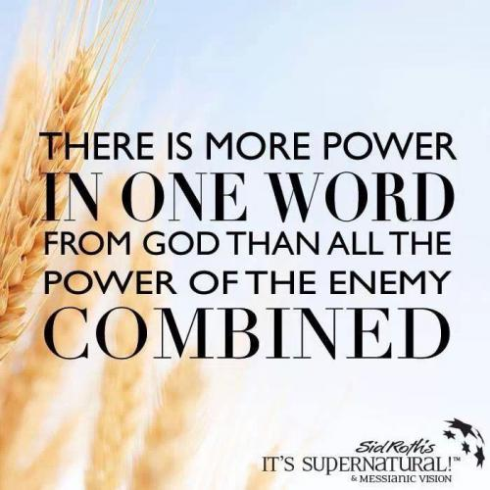
THE DECREE…
GAZAR — to cut, to divide, to cut down, to cut off, to cut in two, to snatch, to decree

Slide 38
DECREE: To judge; to divide.
1. Judicial decision, or determination of a litigated cause; as a decree of the court of chancery. The decision of a court of equity is called a decree; that of a court of law, a judgment.
2. In the civil law, a determination or judgment of the emperor on a suit between parties.
3. An edict or law made by a council for regulating any business within their jurisdiction; as the decrees of ecclesiastical councils.

Slide 39
DECREE: To judge; to divide.
4. In general, an order, edict or law made by a superior as a rule to govern inferiors.
There went a decree from Cesar Augustus, that all the world should be taxed. Luke 2.
5. Established law, or rule.
He made a decree for the rain. Job 20:28.
6. In theology, predetermined purpose of God; the purpose or determination of an immutable Being, whose plan of operations is, like himself, unchangeable.

Slide 40
THE DECREE: The predetermined purpose of God; the purpose or determination of an immutable Being, whose plan of operations is, like himself, unchangeable
Psalm 2:7-8 I will proclaim the decree of the Lord: He said to me, "You are my Son; today I have become your Father. 8 Ask of me, and I will make the nations your inheritance, the ends of the earth your possession.
Proverbs 8:15-16 By me kings reign, and princes decree justice. By me princes rule, and nobles, even all the judges of the earth.

Slide 41
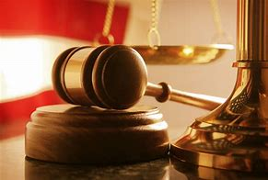
DECREE:
1. To determine judicially; to resolve by sentence; as, the court decreed that the property should be restored; or they decreed a restoration of the property.
2. To determine or resolve legislatively; to fix or appoint; to set or constitute by edict or in purpose.
Thou shalt decree a thing, and it shall be established. Job 22:28

Slide 42
WAGING WAR FIGHT THE GOOD FIGHT
1 Tim 1:18‑19 18 Timothy, my son, I give you this instruction in keeping with the prophecies once made about you, so that by following them you may fight the good fight, 19 holding on to faith and a good conscience. Some have rejected these and so have shipwrecked their faith. NIV
1 Cor 14:1-4
14:1 Follow the way of love and eagerly desire spiritual gifts, especially the gift of prophecy. 2 For anyone who speaks in a tongue does not speak to men but to God. Indeed, no one understands him; he utters mysteries with his spirit. 3 But everyone who prophesies speaks to men for their strengthening, encouragement and comfort. 4 He who speaks in a tongue edifies himself, but he who prophesies edifies the church.

Slide 43
FRAMED
FRAME BY FRAME

Slide 44
FRAME BY FRAME REVELATION THAT BRINGS REVOLUTION!

Slide 45
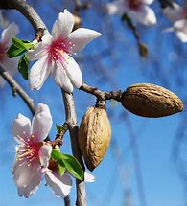
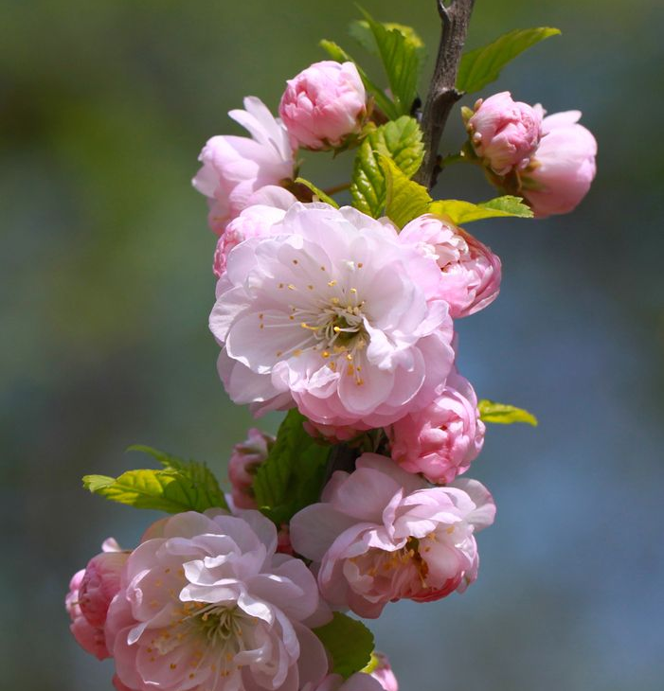
BEFORE I FORMED YOU…

Slide 47
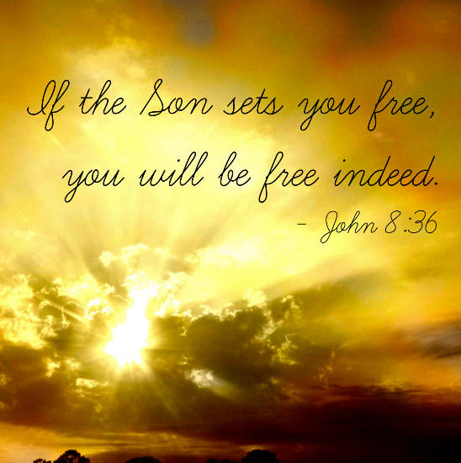
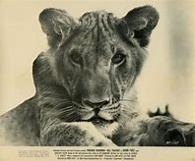
Born free

Slide 48
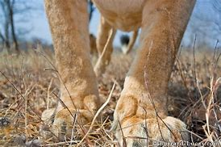
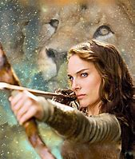
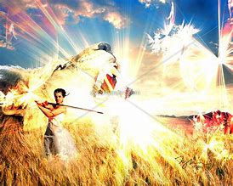
ELSA: TRUTH BORN FREE * LIVE FREE * STAY FREE
LIKE “ELSA”THE LIONESS WHO WAS RESCUED AND SET FREE! WE HAVE COME INTO A SEASON WHERE THE LIONESS IS RISING UP. THE BRIDE IS GOING TO MANIFEST FOR HER BRIDEGROOM. IN SONGS AND SOUNDS, IN A DAY WE HAVE BEEN DESTINED FOR. IT IS GOING TO SPRINGFORTH IN THE HEAVENS AND THE EARTH! THE BRIDE IS GOING TO RISE. WE WILL WALK IN THE FREEDOM HE HAS PURCHASED!

Slide 49
HABITATION
DEUTERONOMY 11:11-12 But the land you are crossing the Jordan to take possession of is a land of mountains and valleys that drinks rain from heaven. ¹²It is a land the LORD your God cares for; the eyes of the LORD your God are continually on it from the beginning of the year to its end.

Slide 50
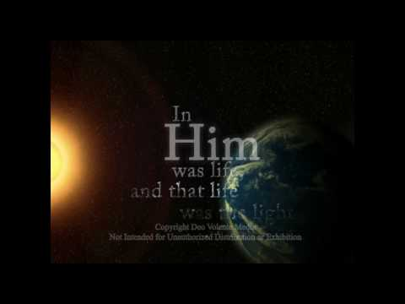
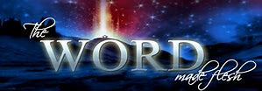
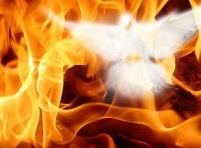
“I am living in the land again- Betty Love! Miracle City Global, you now have HABITATION, My manifestations of My fullness.

Slide 51
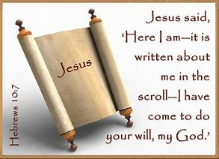
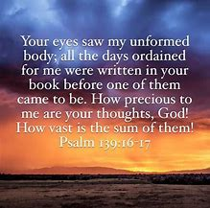
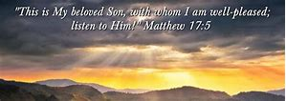
THE GOLDEN BOOKS! I have opened my favorite books in this season - l’m reading and decreeing over My people what is written. My voice comes again- again to say, “This is my son, whom I love, with him I am well pleased!”

Slide 52
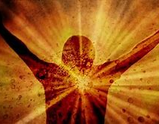
BAPTISM OF HOLY SPIRIT FIRE RESTORATION
I am releasing a fresh Baptism of My Holy Spirit! You are going into the wilderness- NOT TO BE TEMPTED- but to see Leviathan cut up and to eat your meal! You are going into the wilderness to receive the restoration of your vineyard!
Psalm 74:14 You broke the heads of leviathan in pieces, and gave him to be food to the people inhabiting the wilderness.

Slide 53
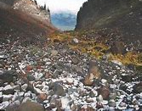
RESTORATION OF YOUR VINEYARDS…
Hosea 2:14-15 "Therefore I am now going to allure her; I will lead her into the desert and speak tenderly to her. 15 There I will give her back her vineyards,and will make the Valley of Achor a door of hope. There she will sing as in the days of her youth, as in the day she came up out of Egypt.

Slide 54
I LIVE ONLY TO SEE YOUR FACE

