Slide 1
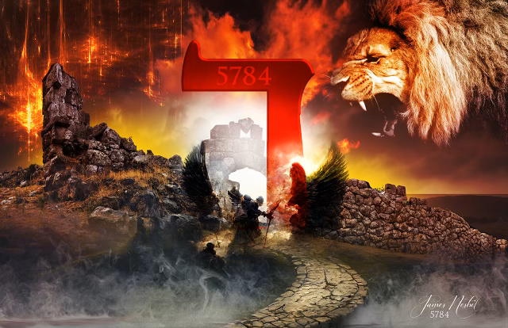

Slide 2
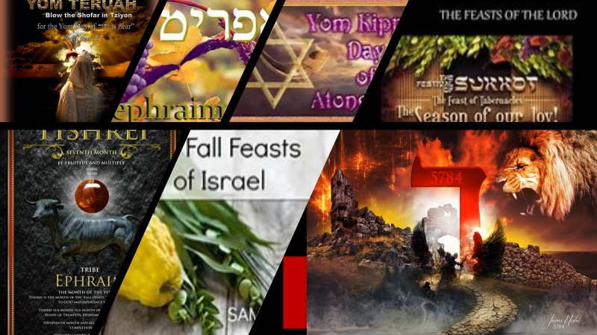
ROSH HASHANAH 5784
PEY DALET
THE GATE
THE DOOR
THE VEIL

Slide 3
ROSH HASHANAH 5784
PEY DALET
THE YEAR OF THE OPEN DOOR
GATES AND DOOR
THE DOOR OF ADVANCEMENT

Slide 4
ROSH HASHANAH 5784
PEY DALET
“I know your deeds. See, I have placed before you an open door that no one can shut. I know that you have little strength, yet you have kept my word and have not denied my name.” – Revelation 3:8

Slide 5
ROSH HASHANAH 5784
PEY DALET
LIFT UP YOUR HEADS OH YE GATES BE LIFTED UP YOU ANCIENT DOOR
LET THE KING OF GLORY COME

Slide 6
ROSH HASHANAH 5784
PEY DALET
WE WILL NOT BE PUT TO SHAME WHEN WE CONTEND WITH OUR ENEMIES IN THE GATE!

Slide 7
ROSH HASHANAH 5784
PEY DALET
THE WAR OVER YOUR DOOR OF PROMISE
GATES/DOORS

Slide 8
ROSH HASHANAH 5784 RELATING TO GOD
On Rosh Hashanah we relate to God as a subject to his king. Rosh Hashanah is the day that we proclaim God's kingdom over us, and accept His yoke. The special prayers that we recite on Rosh Hashanah all revolve around this theme. On Rosh Hashanah we do not specify our sins in detail. Rather, we focus on devoting ourselves to the King and to reawakening in Him the desire to rule over us.

Slide 9
ROSH HASHANAH 5784 RULING OVER TIME
When we define Rosh Hashanah as the day that we establish God's kingdom over us, we also define our relationship to time itself. Rosh Hashanah means "the head of the year." A year without a head is time without a king -- time that is equal and "democratic." When time has no king, events flow in an unending routine of cause and effect, with no unexpected change of direction or purpose. When we affix a head to time, we allow for change.

Slide 10
ROSH HASHANAH 5784 RULING OVER TIME
Rosh Hashanah is the day that time opens up to the wonder of change and allows the potential for change to penetrate it. This is the day that we meet the source of time. When the days are willing to diverge from their routine, the desire to reveal God's exaltedness is awakened and leads time itself at a new pace and in unmapped directions.

Slide 11
ROSH HASHANAH 5784 ENLISTMENT DAY
Rosh Hashanah is the day that we enlist in the army of God. It is the day that every citizen becomes a soldier. From now on, the soldier agrees to do all that he is ordered without question. He understands that he will be judged according to his degree of obedience. Further, this enlistment in the army and "mission mentality" awaken the soldier to turn his attention away from himself and toward his mission. He no longer considers himself the focal point of his reality.

Slide 12
ROSH HASHANAH 5784 ENLISTMENT DAY
His main desire is that the king's mission be accomplished, even if he is not the one to carry it out. A person who has achieved soldier consciousness also realizes that even if he has personally ascended to greater spiritual heights, his main goal is the ascent of the entire nation and of all humanity. Soldier consciousness creates the spirit of mutual responsibility, solidarity, and cooperation before God.

Slide 13
ROSH HASHANAH 5784 DAY OF REMEMBRANCE
Rosh Hashanah is also called the Day of Remembrance. On this day God remembers that His nation is like a glowing ember whose source is in the great flame of devotion of our souls to Him. Thus, when God comes to rule over us with might, He is not coercing us to accept an artificial yoke, foreign to our inner spirit. On the contrary, God's rule entirely befits us, and awakens our inner spark of devotion to Him

Slide 14
ROSH HASHANAH 5784 DAY OF REMEMBRANCE
When we assess our level of devotion to God on Rosh Hashanah, we often see that not only have we not advanced toward the King's goals, but rather, some of those goals have even receded into the distance. We ask God to understand our lack of devotion not as rebellion, but rather as simple laziness, and to forgive us our debts of unaccomplished goals.

