Slide 1
THE VANTAGE POINT
YOU CAN NOT LIMIT ME
I AM READY TO GIVE YOU A NEW VIEW

Slide 2
A different perspective. Come up higher!
It is a new vantage point!
The vantage with the advantage!

Slide 3
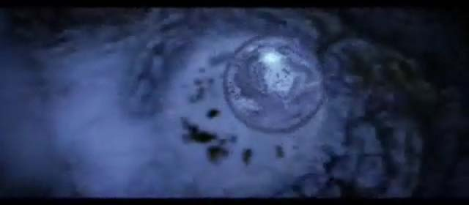
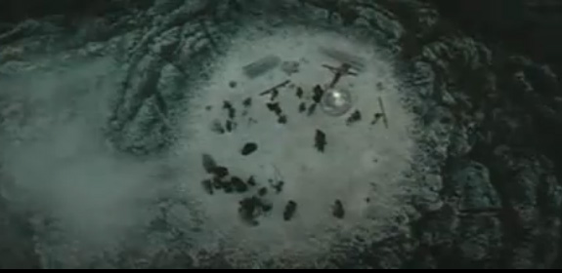
HIS VANTAGE POINT…

Slide 5
…for the joy set before Him, Jesus…
endured the cross, scorning it’s shame
And set down at the right hand of the throne of God. Hebrews 12:2

Slide 6
Vantage Point: a position or place that affords a wide or advantageous perspective; viewpoint
a position or place that allows one a wide or favourable overall view of a scene or situation
the particular ideas or beliefs that influence the way that you think about things

Slide 7
VANTAGE POINT
a position or place that affords a wide or advantageous perspective; viewpoint
a position or place that allows one a wide or favourable overall view of a scene or situation
the particular ideas or beliefs that influence the way that you think about things
VANTAGE POINT

Slide 8
View the ability to see something from a particular place
scene a view that you can see in a picture or from the place where you are
sight any place that you can see from where you are
backdrop everything that you can see behind the main thing you are looking at
panorama a view of a large area of land or water
viewpoint a place from which you can see or watch something

Slide 9
perspective a view of a large area
prospect a view of a wide area of land or water, especially from a high place
vista the view that you can see from a particular place, especially a beautiful view
view the area or place that can be seen
a grandstand view (of something) a view of something in which you are close to it and can see all of it very well

Slide 10
bird’s-eye view a good view of something from a high position
cityscape the way that a city looks, or a particular view of a city
command if a place commands a view, you can see that view from it
landmark a famous building or object that you can see and recognize easily
the lay of the land the way a piece of land looks, especially what hills, valleys, rivers, etc. it contains

Slide 11
the lay of the land the way a situation seems at a particular time. The British phrase is the lie of the land
lookout a place that is suitable for watching whether someone or something is coming, especially in a dangerous situation
the middle distance the area in a view, photograph, painting, etc. that is between the area nearest to you and the area farthest away
outlook l the view from a particular place
overlook to have a view of something from above

Slide 12
-scape used with some nouns to make nouns describing a wide view of a particular type
Shot a view of something that you have because of the position of the camera in movies, television, or photographs
Townscape the appearance of a particular town, especially as it is shown in a picture or photograph
vantage point a position from which you can see things well

Slide 13
YOU CAN NOT LIMIT ME. I AM READY TO GIVE YOU A NEW VIEW, A DIFFERENT PERSPECTIVE. COME UP HIGHER… IT IS A NEW VANTAGE POINT.
THE VANTAGE WITH THE ADVANTAGE…

Slide 15
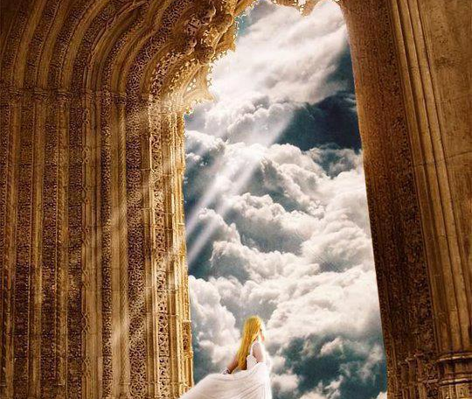
COME UP HIGHER…
I LOOKED AND BEHOLD, A DOOR STANDING OPEN
…I HEARD, LIKE A WAR-TRUMPET…COME UP HERE…

Slide 16
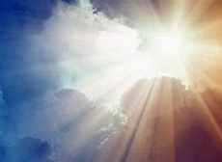
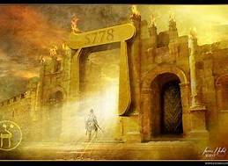
COME UP HIGHER… I LOOKED… I HEARD… I SAW A DOOR…

Slide 17
Revelation 4:1 After this I looked, and behold, a door standing open in heaven! And the first voice which I had heard, like the sound of a [war] trumpet speaking with me, said, “Come up here, and I will show you what must take place after these things.”

Slide 18
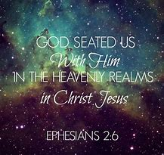
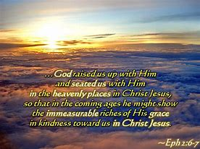
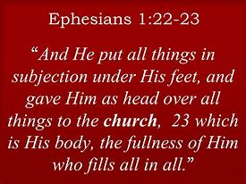
OUR VANTAGE POINT

Slide 19
Matthew 7:7-11 Ask and keep on asking and it will be given to you; seek and keep on seeking and you will find; knock and keep on knocking and the door will be opened to you. ⁸ For everyone who keeps on asking receives, and he who keeps on seeking finds, and to him who keeps on knocking, it will be opened. ⁹ Or what man is there among you who, if his son asks for bread, will [instead] give him a stone? ¹⁰ Or if he asks for a fish, will [instead] give him a snake? ¹¹ If you then, evil (sinful by nature) as you are, know how to give good and advantageous gifts to your children, how much more will your Father who is in heaven [perfect as He is] give what is good and advantageous to those who keep on asking Him.

Slide 20
… how much more will your Father who is in heaven [perfect as He is] give what is good and advantageous to those who keep on asking Him.

Slide 21
John 16:7-16 ⁷ But here’s the truth: It’s to your advantage that I go away, for if I don’t go away the Divine Encourager^{[c]} will not be released to you.

Slide 22
However, I am telling you nothing but the truth when I say it is profitable (good, expedient, advantageous) for you that I go away. Because if I do not go away, the Comforter (Counselor, Helper, Advocate, Intercessor, Strengthener, Standby) will not come to you [into close fellowship with you]; but if I go away, I will send Him to you [to be in close fellowship with you]. AMP

Slide 23
For the one whom God has sent speaks the words of God, for God gives the Spirit without limit.
JOHN 3:34
“The One whom God has sent to represent him will speak the words of God, for God has poured out upon him the fullness of the Holy Spirit without limitation.[

Slide 24
So be very careful how you live, not being like those with no understanding, but live honorably with true wisdom, for we are living in evil times.
Take full advantage of every day as you spend your life for His purposes.
Ephesians 5:15-16

Slide 25
ADVANTAGE
Any state, circumstance, opportunity, or means specially favorable to success, interest, or any desired end.
Advantage, benefit, profit all mean something that is of use or value. Advantage is anything that places one in an improved position, especially in coping with an adversary, opponent, competition or difficulties. Benefit is anything that promotes the welfare or improves the state of a person or group: a benefit to society. Profit is any valuable, useful, or helpful gain: profit from trade or experience

Slide 26
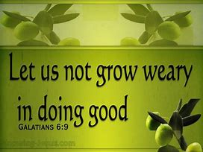
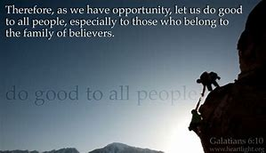
Take advantage of every opportunity to be a blessing to others, especially to our brothers and sisters in the family of faith!
Galatians 6:10

Slide 27
THE VANTAGE WITH THE ADVANTAGE
Ephesians 5:15-16 So be very careful how you live, not being like those with no understanding, but live honorably with true wisdom, for we are living in evil times. Take full advantage of every day as you spend your life for His purposes.
Galatians 6:10 Take advantage of every opportunity to be a blessing to others, especially to our brothers and sisters in the family of faith!

Slide 28
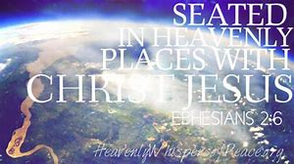
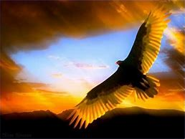
YOU CAN NOT LIMIT ME. I AM READY TO GIVE YOU A NEW VIEW, A DIFFERENT PERSPECTIVE. COME UP HIGHER… IT IS A NEW VANTAGE POINT.
THE VANTAGE WITH THE ADVANTAGE…

