Slide 1
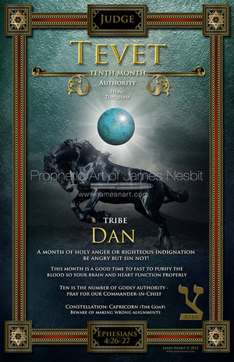

Slide 2
Characteristics
The ending of Hanukkah (in the midst of destruction, there is mercy)
A month of holy anger or righteous indignation; be angry but sin not (Eph 4:26)
The month to pray for your Commander in Chief and those in authority
A good time to fast to purify the blood, so your heart and brain function properly
Stand for your inheritance (Dan 12:13)

Slide 3
Tevet
Pray for new, artistic, and creative expressions, in worship, this month
Praise confounds the enemy (Gen 14:19-20)
Ask God how to form a rear guard over the past season
Pay attention to the prophetic words and promises over your life (do not miss your destiny)
War when God calls you
Put on your armor and stand (Eph 6:10-18,
James 4:7)
Step on the serpents head this month
Stand for your inheritance and…
DON’T BACK DOWN!!

Slide 4
tevet
Tenth month of the twelve months of the Jewish calendar (10 is the number of godly authority)
IMPORTANT!!! PRAY FOR OUR COMMANDER IN CHIEF (so godly authority is established)
Strategy, of the enemy, in this month, is pull leaders away.
The enemy knows when you have a good leader
The enemy will try to get to you, through your leader
PRAY FOR YOUR LEADERS!!!

Slide 5
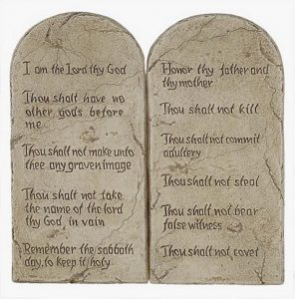
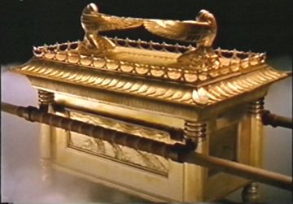
TEVET-10
The number of the testimony
The 10 commandments were in the
Ark of the Testimony

Slide 6
Follow the leader
Follow His lead on the path to your destiny (Proverbs 4:18)
This is the month to get focused
Keep your eyes fixed on Him

Slide 7
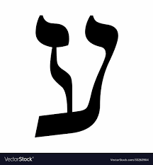
Ayin
16th letter of the Hebrew Alphabet
Numerical value of 70
Perfection and Spiritual Order
To watch, know, understand, obey, and focus on

Slide 8
Ayin
AYIN pictures an eye
The month to let your good eye see
Important as you war against the evil eye and break the power of evil watchers

Slide 9
ayin
The power of the evil eye is there to guide you in the future
Evil eye structures, embedded in our culture, are there to manipulate
We must participate with angelic visitations to guide us and press on through

Slide 10
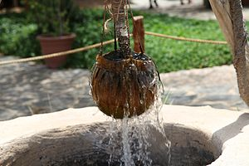
ayin
AYIN also pictures a spring or well
It is time for NEW LIFE to flow

Slide 11
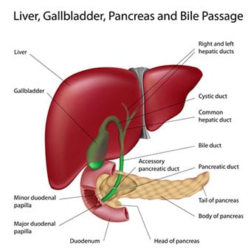
Action/body part
Anger
Liver

Slide 12
tevet
This is the month of holy anger and righteous indignation
Things, that are out of order, start manifesting
We can be angry, but the key is…WE MUST NOT SIN!!
If we cross the fine line, of our emotions, our souls become damaged and our promises will not manifest
Ephesians 4:26-27
“In your anger do not sin…Do not let the sun go down while you are still angry, and do not give the devil a foothold.”
Break out of fear and passivity (2 Tim 1:7)

Slide 13
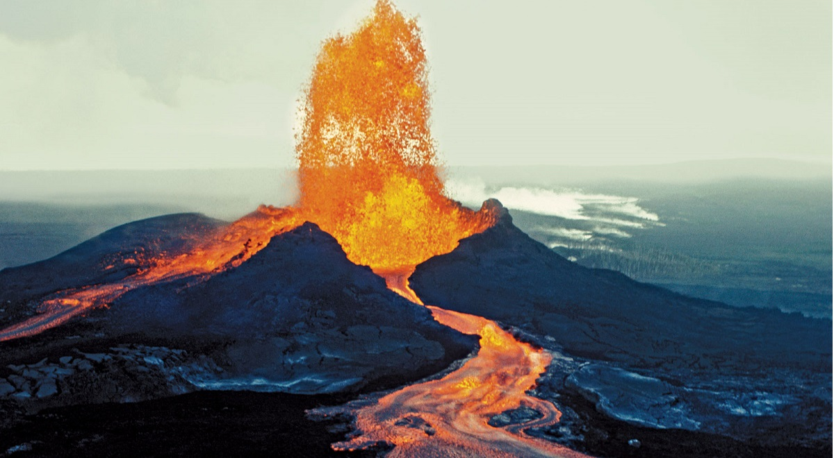
tevet
Spend time, during the year, making sure your emotions are under the control of the Spirit of God
If they are not, then there will be an eruption
The damage would have been already done
Exercise spiritual discipline throughout the year to avoid the eruption

Slide 14
Action/body part
Anger
Liver

Slide 15
Tevet be sure your blood is cleansed and purified
Impurities in the blood can be linked to our sexual lives
Violating Firstfruits sexually, the blood has to be purified, so the brain and heart can function right
Proverbs 7

Slide 16
Tevet fasting
Good time for a fast
Brings reflection as we are approaching a new Roman calendar year and the last quarter of the Hebraic calendar

Slide 17
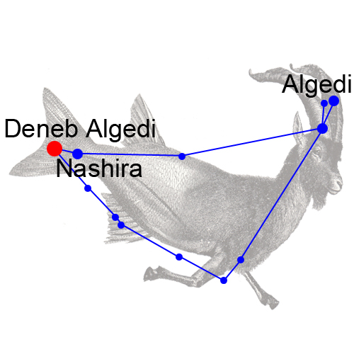
Constellation Capricorn (the goat)
Beware of making wrong alignments

Slide 18
capricorn
Nations, that are not allies of covenant (Goat Nations), will start to take wrong turns
Month to leap forth
Goat was a sin offering for Israel (Lev 10:16-17)

Slide 19
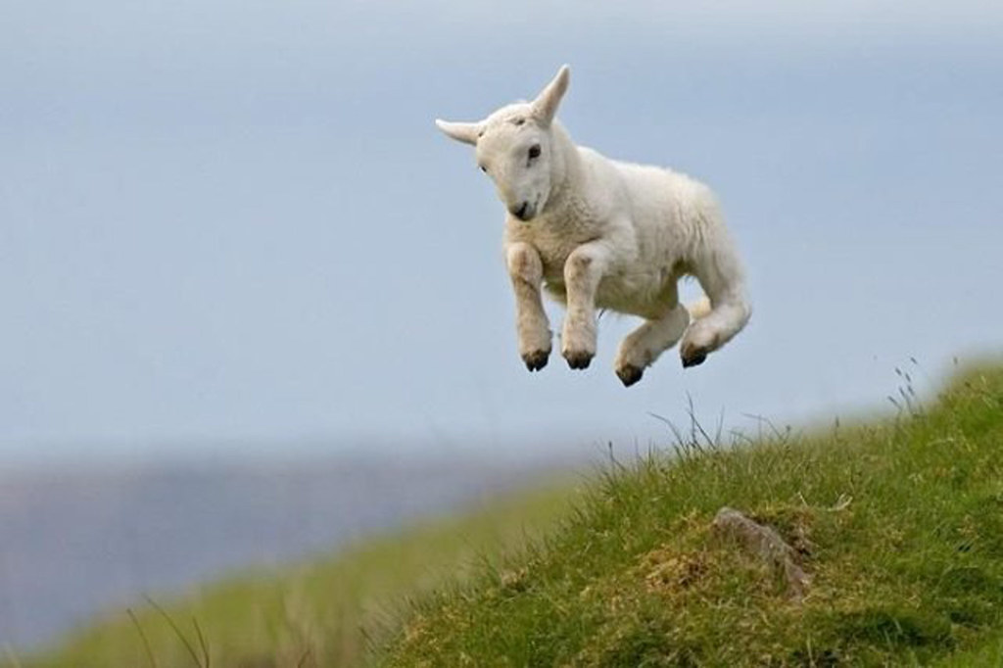
Leaping forward
Leap forward like a goat!!
Your testimony will either express immaturity or maturity
What is your testimony?
Did you get delivered?
Does ‘that thing” bother or overwhelm you anymore?

Slide 20
tevet
This month begins the winter season (Tevet, Shevat, and Adar)
These months correspond to the three tribes of the camp of Dan (Dan, Asher, and Naphtali)
They were all situated on the north side of the tabernacle

Slide 21
dan
5th son of Jacob
1st son of Rachel by Bilhah
Name means—to rule, to judge, or to execute judgment
Genesis 49:16-18 (Jacob’s blessing) (rule among the tribes)
Deuteronomy 33:22 (Moses’ blessing the tribe) (Bashan was one of the first territories, Israel conquered)

Slide 22
dan
Dan’s territory was the place where Jeroboam set up one of the golden calves. Thus leading Israel into idolatry
Part of Dan’s redemptive call was to “leap” from idolatry, which he did not do
The tribe of Dan had a great artistic anointing particularly with metals and fabrics (Oholiab and Bezalel were called to create furniture and furnishings for the Tabernacle)

Slide 23
dan
Dan was grouped with Naphtali and Asher on the north side of the Tabernacle and they marched out last forming the rear guard (this is where being the “snake in the path” comes into play causing those who pursue Israel to fall back
The sons of Dan, in Judges 18, stole the priest and household idols, of a man named Micah, then they burned Laish.
The book of Revelation list 12,000 from each tribe sealed, the tribe of Dan is not listed
Idolatry could be the reason the Lord refused to seal Dan as an overcomer in the end

Slide 24
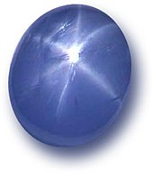
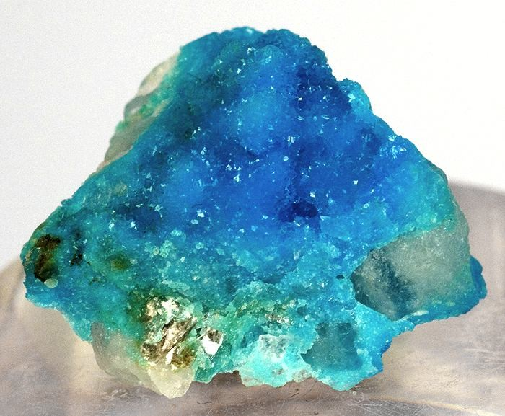
Color/stone Turquoise/sapphire

