Slide 1
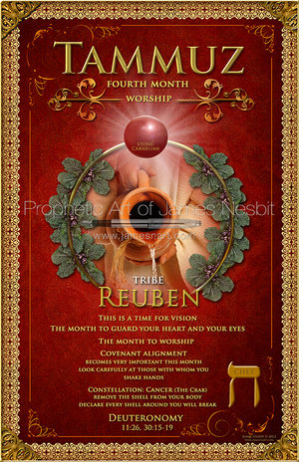

Slide 2
TAMMUZ
The 4th month in the Jewish calendar
The 1st of the 3 summer season months (Tammuz, Av, and Elul)
These are the 3 tribes of the camp of Reuben (Reuben, Simeon, and Gad)
They were situated to the south of the Tabernacle

Slide 3
characteristics
The month to guard you heart and your eyes (Deut 11:26, 30:15-19)
The “Film Strip” month—watch your progress and adjust
The month to WORSHIP
The time for VISION…see what you see and look again
Covenant alignment month…notice all of your handshakes this month (Song of Solomon 5:2-12)

Slide 4
TAMMUZ
This is the month Israel sinned and made the golden calf
This lead to the breaking of the first set of tablets given to Moses by God
The 17th of Tammuz through the 9th of Av commemorates the destruction of the Temple in Jerusalem
The month the spies traveled through the Promise Land

Slide 5
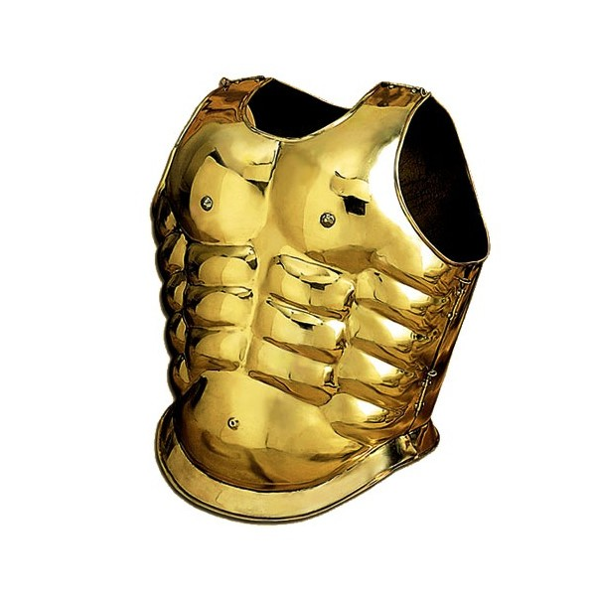
TAMMUZ
Establish the brilliance of your righteousness
We walk in the righteousness of God
We have a breastplate of righteousness
If your righteousness does not shine this month, beware of negative attacks
Watch the events taking place in the earth

Slide 6
TAMMUZ
Move through this month with worship
The lack of brilliant worship can open the door to idolatry
The “golden calf” can kick up this month
Do not come into agreement with the development of a “golden calf”
Worship the Lord in Spirit and Truth

Slide 7
TAMMUZ
Watch your mouth and confess the BEST the Lord has for you
Agree with His call on your life
Do not speak an evil report
Accept your call and speak forth your destiny
Speak out who you are
Don’t fall into negativity

Slide 8
TAMMUZ
FIND AND KNOW YOURSELF!!!
The Lord made you for PURPOSE and DESTINY
God does not make junk
Find your redemptive role in life, to avoid being miserable over an identity that you never tap into
Don’t speak evil reports about yourself as a result of something created in the atmosphere

Slide 9
TAMMUZ
“Filmstrip” Month
Review your progression and stop to make adjustments
God can show you where you’ll end up if you don’t make the necessary changes

Slide 10
reuben
Jacob and Leah’s 1st son (their firstfruit) (Gen 29:32)
His name means—Behold a Son
Reuben’s downfall (Gen 35:22) This changed the course of Reuben’s life
This action revealed his inability to maintain self control under pressure.
Jacob removed the “Right of the First-Born” from Reuben and gave it to Joseph.

Slide 11
reuben
Reuben chose not to be consumed by rejection, self pity, or revenge
He demonstrated the fruit of repentance in how he lived the rest of his life
The rest of his life, his actions demonstrated love and concern towards his brothers, father, and family.
He stopped his other brothers from killing Joseph
He was going to go and rescue him from the pit to restore him back to his father
He offered the lives of his two sons to spare the life of Benjamin
Even though he lost the position of first born, he acted like the first born

Slide 12
reuben
Jacob’s blessing—Genesis 49:3-4 (Reminder of his transgressions)
Moses’s Blessings of the Tribes—Deut 33:6 (A redemptive word)

Slide 13
reuben
The tribe of Reuben was paired with Simeon and Gad in the wilderness
They camped on the south of the Tabernacle
They were second group to march out after Judah, Issachar, and Zebulun
They had the second largest number of warriors just behind Judah, Issachar, and Zebulun
They chose to take the land east of the Jordan River, but faithfully fought along side the other tribes to secure Canaan.

Slide 14
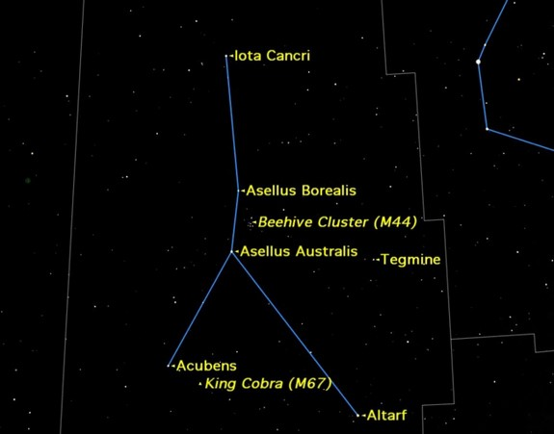
CONSTELLATION cancer the crab

Slide 15
SIGNS IN THE SKY
Satan is trying to pervert what God has created
Satan has enticed mankind to use the heavens for an ungodly purpose
Astrology is man’s attempt to discern the future from the stars and gain revelation without having to seek God or hear His voice (Greek Mindset)
Astrology is a form of divination, which is a sin
Dabbling in horoscopes will open a door to demonic oppression in your life

Slide 16
Signs in the sky
The sun, moon, and the stars were established by God and set into place, for His glory
Psalms 8
Job 9:8-10
Psalms 19:1
Scriptures validate that there is nothing evil about the sun, moon, or the constellations…they are all God’s creation
The heavens were established, by God, as a gift, to provide us with revelation of who He is
Reminds us of the “times” God has established for us to seek Him.

Slide 17
Signs and seasons
Gen 1:14
Signs-Hebrew word oth (a signal, omen, or warning)
The wise men saw a bright star in the east, which was a signal, from God, that the Messiah had come (Matthew 2)
In the last days there will be “signs in the sky” (Matthew 24:30 and Acts 2:19)

Slide 18
Signs and seasons
Gen 1:14
Seasons-Hebrew word mo’ed (appointed time)
Mo’ed is the same word used for a biblical feast or festival
The stars are there to mark our seasons and more particularly, to remind us of the “appointed times”, to meet with Him

Slide 19
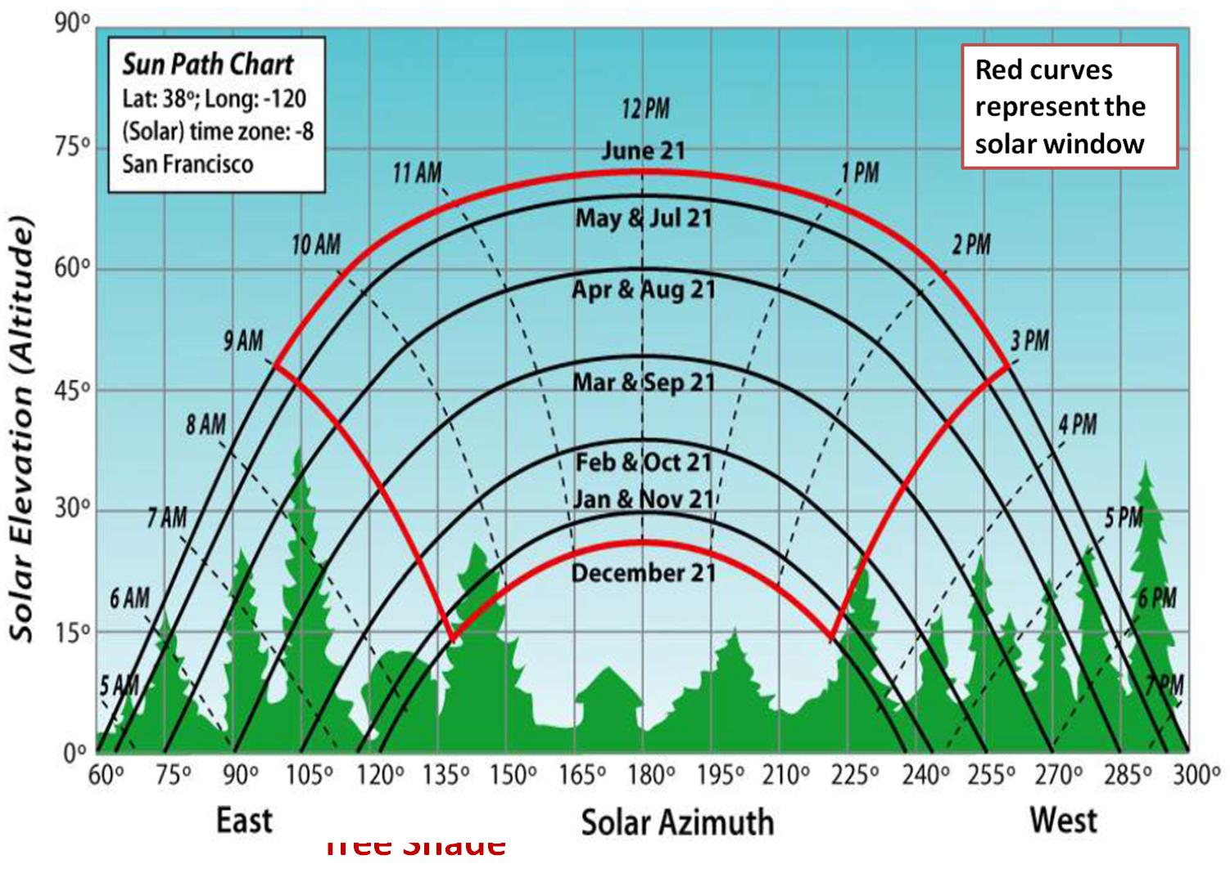

Slide 20
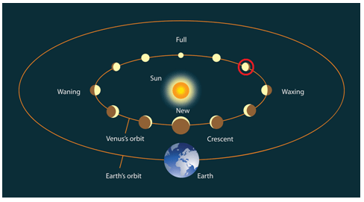

Slide 21
GOD’S CLOCK IN THE SKY
The sun, moon, and stars are positioned, by God, for a purpose
The Jews saw the universe as a “giant clock”
The days are marked, by the cycle, of the sun, and the time, of day, is marked, by the position, of the sun, in the sky
12 times a year, God arranged, for the moon to go through a complete cycle, which divided our year into 12 months (the word month comes from the same root as the word moon)
The Jews would watch for the new moon to appear, so they can declare “The new month has begun”

Slide 22
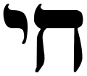
The letter of the month chet
Light radiating from your eyes
The light we have been working on through the last months needs to be seen in our eyes
Watch Out!!
The devil will try to put out the light in our eyes

Slide 23
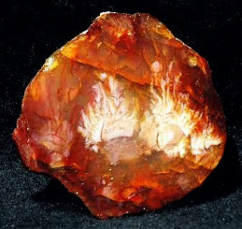
COLOR/STONE
RED
Atonement
Blood
Life
Death
Flesh
Love
of God
CARNELIAN
Exodus 28:17
Exodus 39:10
Ezekiel 28:13

