Slide 1
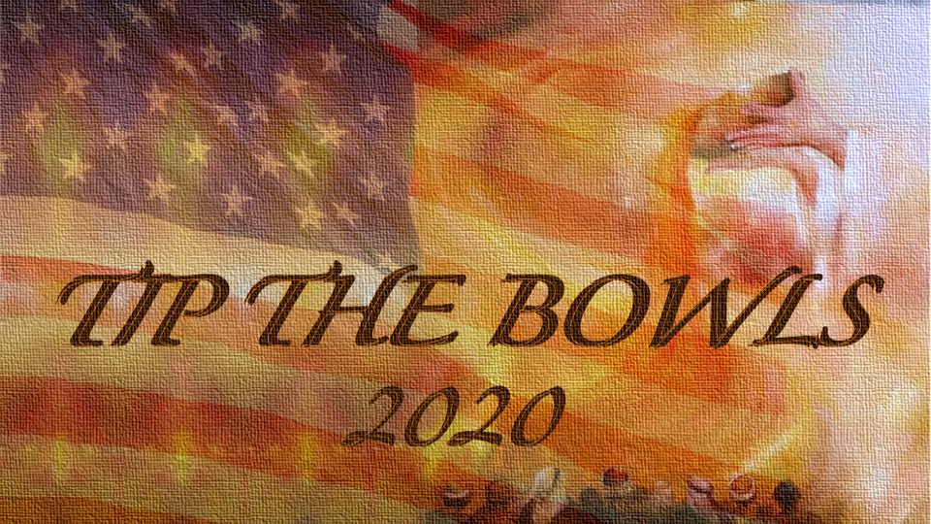

Slide 2
“And when He had taken the scroll, the four living creatures and the twenty-four elder"s fell down before the Lamb, each holding a harp, and golden bowls full of incense, which are the prayers of the saints." (Revelation 5:8; ESV)

Slide 3
I will build My church, and the gates of Hades will not prevail against it. I will give you the keys of the kingdom of heaven. Whatever you bind on earth will be bound in heaven, and whatever you loose on earth will be loosed in heaven.”… (Matthew 16:18; BSB)

Slide 4
“I also tell you this: If two of you agree here on earth concerning anything you ask, my Father in heaven will do it for you.” (Matthew 18:19 ; NLT)

Slide 5
“You will also decide and decree a thing, and it will be established for you; And the light [of God’s favor] will shine upon your ways.” (Job 22:28; AMP)

Slide 6
THE VISION “For once again, I will see the Blood Covenant – and hear the cry of a righteous remnant in the land. It is time! Your covenant with death will be annulled; your agreement with the grave will not stand in this nation (Isaiah 28:18). The sin of a nation has reached its fullness; but the bowls of all the prayer movements have reached their fullness (Revelation 5:8 & 8:3). I will see and hear the outcry of my people and TIP YOUR PRAYER BOWLS, AMERICA! Revival… Awakening… and Reformation will come again to this nation.” (Betty Love, 70 Day Decree Vision, 1/31/2019)

Slide 7
THE DECREE "I heard Jesus say, “TIP THE BOWLS!” Vision of the Cloud of Witnesses in heaven with hands raised and voices raised saying, ‘TIP THE BOWLS!” and I heard the voice of the Ekklesia in our nation and the nations of the earth say, "TIP THE BOWLS" Our response: WE SAY/THE EKKLESIA SAYS, “TIP THE BOWLS!” (Betty Love, Word/Vision War Words from the Womb of the Dawn, 9/1/2020)

Slide 8
We invite the righteous remnant and every born-again believer to lift your voice daily for 55 days in agreement and decree: "Tip the Bowls"! We invite every functioning Ekklesia to come into agreement and Decree: "Tip the Bowls'!

Slide 10
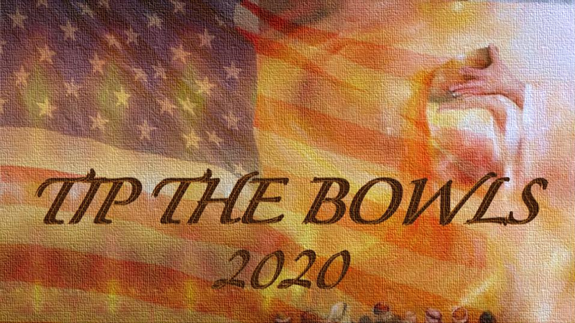
TOUR OF DUTY…
RELEASING THE PROPHETIC DESTINY OF OUR NATION!
REVISIT , RELEASE, REVIVE, REBUILD, RESTORE, REFORM, TRANSFORM…
WAR WORDS FROM THE WOMB OF THE DAWN

Slide 11
REBUILDING THE WALL OF RIGHTEOUSNESS IN OUR NATION, STATES, AND TERRITORIES “I looked for someone who might rebuild the wall of righteousness that guards the land. I searched for someone to stand in the gap in the wall so I wouldn’t have to destroy the land…” (Ezekiel 22:20;NLT)

Slide 12
REBUILDING THE WALL OF RIGHTEOUSNESS IN OUR NATION, STATES, AND TERRITORIES “They will rebuild the ancient ruins and restore the places long devastated; they will renew the ruined cities that have been devastated for generations.” (Isaiah 61:4; NIV)

Slide 13
JOIN THIS STRATEGIC TOUR AS WE TRAVEL IN PRAYER TO THE GATES OF ALL 50 STATES AND US TERRITORIES. WE WILL FUNCTION AS THE EKKLESIA IN OUR NATION’S GATE WAGING WAR WITH PROPHETIC WORDS SPOKEN OVER EACH STATE AND WITH THE DECREE “Tip the Bowls!” (Revelation 5:8)

Slide 14
DURING THE FIRST 52 DAYS WE WILL BE REVISITING THE 52 DAY INITIATIVE FROM THE 70 DAY DECREE, REBUILDING THE WALL OF RIGHTEOUSNESS IN OUR NATION, STATES, AND TERRITORIES IN ORDER TO RELEASE THE PROPHETIC DESTINY AND REDEMPTIVE PLAN OF GOD IN EACH STATE AND OUR NATION. WE WILL SEE THE FULFILLMENT OF THE PLAN OF GOD FOR OUR NATION! AMERICA WILL BE SAVED!

