Slide 1
A TIME TO PROSPER
CHUCK PIERCE & ROBERT HEIDLER

Slide 2
The Domino Effect
JOY IS THE KEY

Slide 3
Expect God to Bring Change and Renewal in Your Life
Is anything too hard for our God? NO!
When we walk in defeat, we are blinded to our future and the prosperity that the Lord has for us.
God has ways to redeem what has been lost and to open our eyes to the future.
This is an amazing testimony of God’s ability to keep those things we have committed to Him.

Slide 4
COMMIT UNTO GOD
Proverbs 16:3 ”Commit your actions unto the Lord, and your plans will succeed.”
Colossians 3:23 “Whatever you do, work at it with all your heart, as working for the Lord, not for human masters.”
Psalm 37:5 “Commit your way unto the Lord, trust in Him, and He will act.”

Slide 5
Lift Your Eyes
Look and look again! God is here! He will give you signposts of how change and renewal can come into your life in a moment.
In an instant, everything can change. God comes down and reveals Himself, and you see into a realm that you could not see before.
Signs point you along the way to find your path of faith!
He guides you to a new season.
This is a perfect time for you to war your way into the provisional inheritance for your future!

Slide 6
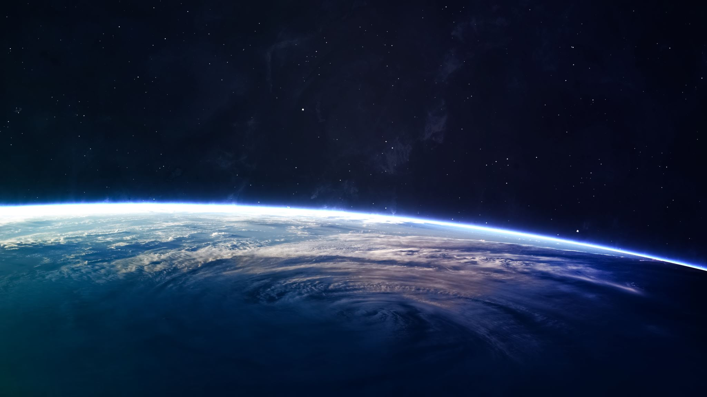
John 16:33
“I have told you all this so that you may have peace in Me. Here on the earth you will have many trials and sorrows. But take heart, because I have overcome the world.”

Slide 7
It is in His Name: He’s Got Just What I Need
In scripture, God reveals Himself in many ways. One way is through His names that echo and personify who He is. In turn, bringing better understanding to us as believers. Take hold of His Covenant names!

Slide 8
Names of God
Jireh –The Lord will provide.
Rophe – Healer.
Nissi – Banner.
M’Kaddesh – Holy.
Shalom – Peace.
Tsidkenu – Righteousness.
Rohi – The Lord is my Shepherd.
Shammah – Jehovah is there.

Slide 9
Jireh
The Lord will provide.
“I have provision for you top see.” God revealed this at Moriah (Genesis 22:1-19), at what would become the threshing floors purchased by David (2 Chronicles 3:1) to display His future plans.

Slide 10
Rophe
Healer.
God’s revelation of this aspect of His Character is described in the book of redemption, Exodus. At Marah, God showed that He heals life’s wounds and sweetens life’s bitter experiences.
Exodus 15:22-27

Slide 11
Nissi
Banner.
God came down at Rephidim during the battle with Amalek. God revealed that He would do miracles and wage war in a hostile world on behalf of His covenant people.
Exodus 17:8-16

Slide 12
M’Kaddesh
Holy.
“I will show you the holy way to walk.” God began a new experience of setting His people apart.
Leviticus 20:7-8

Slide 13
Shalom
Peace.
“I will atone, bring harmony, and produce wholeness.” God revealed who He was to Gideon. He later said, “You have entered into rest, but…”
Judges 6:11-24
Isaiah 30:15

Slide 14
Tsidkenu
Righteousness.
To Jeremiah, God showed Himself as a Righteous Branch and King who would appear in the future (Jeremiah 23:5-6).
In doing this, He let His people know that His promise would never fail. The people might fail in their stewardship of the promise, but God would never fail. Eventually, He would bring the people back into right standing in the land He had given them.

Slide 15
Rohi
The Lord is my Shepherd.
God showed His people the need to follow Him. “I will feed and lead my flock to pasture.” David’s life and his journeys became a prototype of God doing this in the lives of those who had covenant with Him.
Psalm 23

Slide 16
Shammah
Jehovah is there.
“At your lowest ebb, I will be there.” Even as the Israelites were in exile, God revealed that they would be restored.
Ezekiel 48:35

Slide 17
Know God – Know Who He Says He Is
There is a place and time, a moment of change, where God Himself comes down and shows each one of us that whatever we need and whenever we need, in Him we are fulfilled – HE IS ALL.
Once we learn God’s method of “adding to,” we can begin to “add to” our identity and our level of abundance.
Proverbs 3

Slide 18
Aligning Our Expectations
As human beings, we are at odds constantly with our fleshly desires, our godly desires, and our limited understanding of destiny and time. We live in a world that blares the messages of following whims, doing what you feel, and creating your destiny, without ever mentioning the Father’s plan. It is very easy to get out of God’s timing in our quest to get what we hope for and to miss destiny moments along the way.
Jeremiah 29:11

Slide 19
Learn How to See Your Blessing
Do not limit God by wanting things to happen ‘your way’. Remember, His ways are higher than our ways.
One key to seeing God’s path of blessing is to look beyond where you are so that you can see into the place that the Lord has already prepared for you. When you have vision, you do not go backward; you expect the Lord to perform His word on your behalf. Let the shout of the Lord rise up, and may you shout, “My blessings are on the way!”

Slide 20
See Your Future and Go Beyond
Hebrews 3:7-8, 13-15, AMP
Hebrews 4:6-7 AMP
(pages 46-47)

Slide 21
Time:
You must break into God’s cycles of blessings, see new doorways, and go beyond your present. Open your heart and your mind to the reality of God’s presence in every cycle of your life, and prepare to shift into new calls and new victories.

Slide 22
Satan’s Plan Is to Divert Us from God’s Path
Cares of this world.
Anxiety.
Weights on our spirits.
Unforgiveness.
Poisoned spirits.
Grief.
Unstable emotions.
Accusations.
Condemnation.
Sin & iniquitous patterns.
(pages 49-50)

Slide 23
Let Go & Prosper
The greatest war we face is over increase.
We were meant to increase, not just to maintain.
We are being transitioned and repositioned in this new season. Now is the time for us to break past destructive ways of working and old, cyclical poverty mentalities. We must move out of our up-and-down ways, which are creating emotional instability.
We must break the power of the rule by the flesh, we must get to know the Holy Spirit, and we must yield to God’s ways.
We must embrace the war of the season ahead and leave the old wars of last season.

Slide 24
We are Called to Prosper!
We are called to prosper! Not just with material blessings, but also in our call and every other aspect of our lives.
“Beloved, I pray you to prosper concerning all things and to be in good health, as your soul also prospers.”
3 John 1:2 (BSB)

Slide 25
The War for Prosperity
Cross over and prosper!
Be like Abraham!
Enter into the covenant we have through Jesus!
(pages 53-55)

Slide 26
Prosperity in Circumcision
For Abraham, the sign of submission came when he was 99.
El Shaddai, “The Sufficient God,” called Abram to perfection.
Genesis 17 – The Lord is saying “Weaken your organ of propensity (the way of prosperity through flesh) and then watch me multiply you. I am a miracle-working, sufficient God. Take My sign of covenant, cut away, be perfect, and then conceive in holiness. I will change your name from Father of One Land (Abram) and make you Father of Many Nations (or Multitudes).”
Abram’s identity was being shifted to prove that his prosperity and propensity in the future were not to be dependent upon himself.

Slide 27
Prosperity in Circumcision
The prosperity from our own flesh does not last. However, when we stop and recognize God’s sufficiency, He acts to secure our inheritance!
We must demonstrate our faith by works, but our relationship with God cannot be merited through works.
Abraham would multiply by “cutting” a covenant relationship with a holy God.
All of those who align with Abraham will have the same ability to prosper and multiply if they trust and rely on God who aligns with them.

Slide 28
Prosperity in Circumcision
Understanding Holiness
How Prosperity Works
You are a Hebrew

Slide 29
Understanding Holiness
Holiness is one of the foundational principles in the Word of God.
Holiness means not the common to the world’s blueprint. You can flow in the Spirit without having to have your hair or clothes look a certain way. Holiness allows you to be free to wear your hair any way you wish as long as it enhances God’s character and reflection through you.
Holiness does not mean you follow a long, legalistic set of rules of what not to do. Holiness is about showing honor, so it does require a need to honor your body so it doesn’t become defiled.
Holiness also means you honor God by putting Him first in every area of your life. If you understand holiness, then you will better understand what we discuss about firstfruits, which is an outward action of putting God first and giving God the first in every area. (page 56)

Slide 30
How Prosperity
When you enter into the fullness of God’s plan for your life, God begins to bring you to your land, just as He promised to do for Abraham.
When you submit to His plan of prosperity for your life, He cleanses you from all idolatry and unfaithful ways. This submission causes a heart of stone to be replaced with a heart of flesh (a tender heart to hear God). He places His Spirit within you.
He then opens doors that are linked to abundance- not just worldly abundance, but abundance of revelation to understand who God your Creator is through His Son as well as who you are. He blesses the works of your hands. He fills you with revelation. He gives you a boundary and says, “Take dominion! Prosper on every front. Be like Nehemiah.”
(In his day, Nehemiah saw Jerusalem in ruins and began to rebuild walls, restore gates, hang doors, and ready the place for a new move of worship.)
(pages 56-57)

Slide 31
You Are a Hebrew
Through Christ, you are grafted into the inheritance of Abraham, so you are a Hebrew. The Bible is written from a Hebraic perspective. As a Hebrew, you have access to God’s calendar. You can understand the time to cross over into the new. As we’ve discussed, Abram, the Hebrew – the one who crossed over - was the key to our becoming who we are destined to be.
When we move by faith, we cross over from one places in our lives to another. We go from blessing to blessing. Because God’s plan was to graft us into the blessings of Abraham, we must use the covenant revelation that was released biblically to help us tell time.

Slide 32
You are a Hebrew
The Lord built His revelation to people around three feast seasons:
Passover, a celebration of our deliverance and redemption
Pentecost, a celebration of God’s provision
Tabernacles, a celebration of our fullness in God
Jesus fulfilled all the feasts, but now we and the nations must enter into the blessings of the feasts. The time for that is now, because we can access and see into a new dimension of God’s plan in the earth.
(page 570

