Slide 1
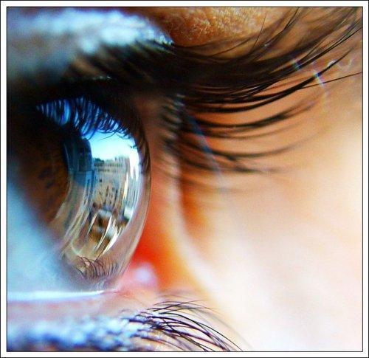
VISION: 2020

Slide 2
VISION: Divine Revelations
REVELATION: The Uncovering of something hidden

Slide 3
VISION
God’s revelation or Word to an individual regarding His divine intent, purpose, and plan for the individual’s live – both present and future. A vision is present and progressive often partially revealed. It is personal and corporate having a distinct cause and effect on the Body of Christ. It is territorial and generational.

Slide 4
VISION: Divine Revelations
REVELATION: The Uncovering of something hidden

Slide 6
VISION VICTIMS
Proverbs 29:18
Where there is no vision, the people perish: KJV
Proverbs 29:18
Where there is no revelation, the people cast off restraint; but blessed is he who keeps the law. NIV
RESTRAINT - PARA (Hebrew) ignore, avoid, get out of control, hold back, running wild, taking away, unkempt (untidy)
Hosea 4:6
My people are destroyed from lack of knowledge. NIV

Slide 8
NEARSIGHTED

Slide 9
FARSIGHTED

Slide 10
TUNNEL VISION

Slide 11
STIGMATISM

