Slide 1
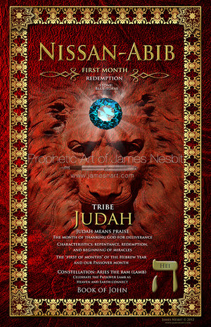

Slide 2
Nissan-Abib(Aviv)
The Hebraic month of Nissan or Abib(Aviv) is the first of the twelve months in the Jewish calendar.
Abib(Aviv) is a Hebraic term for the stage of growth of grain when the seeds have reached full size.
The harvest was waved before the Lord this month
(Lev 23:4-11)
Pray over your firstfruits giving and other offerings this month and wave them before the Lord declaring that the fullness of your harvest is being secured and every seed sowed will prosper in new ways.

Slide 3
Nissan-Abib(Aviv)
Originally, the Hebrew year started in the month of Tishri, but when God initiated Passover, He put Israel into a yearly cycle of redemption and commanded that Nissan now be the head of the months.
The first commandment given to them, from God, when they were preparing to leave Egypt was: “This month (the month of Nissan) shall be for you the first of the months”
While the Hebrew years are still numbered from Tishrei (the first of Tishrei is Rosh HaShanna, the head of the year), the months are now numbered from Nissan. That’s why the Jewish “New Year” begins at the start of the seventh month.
Shows how important God saw Passover and the month of Nissan to be.

Slide 4
Nissan-Abib(Aviv)
The month of Nissan begins, in particular, the period (tekufah) of the spring. The three months of this period--Nissan, Iyar, Sivan--correspond to the three tribes of the camp of Judah--Judah, Issachar, Zebulun--who were situated to the east of the Tabernacle. In the Torah, Nissan is referred to as "the month of the spring" (חודש האביב).

Slide 5
Nissan-Abib(Aviv)
In addition, Nissan is the first of the six summer months, which correspond to six levels of direct light (in Divine service--"arousal from above"). This is alluded to in its synonym "the month of spring" (אביב), whose first two letters, alef (א) and beit (ב),are in the direct or straight order of the Hebrew alphabet.

Slide 6
Characteristics
Repentance
Redemption
Beginning of Miracles
This is a month for you to watch your speech, which provides the ability to express your deepest feelings and insights
This is also the time to put your best foot forward
This is the time you want to be sure to ask God to enter into the full redemptive plan for your life.
God has called some to operate in miracles, which is part of your gifting and destiny.

Slide 7
Letter: Hei (ה)
Pictures wind, breath, and praise
Prophetically this signifies a window with the wind
of God blowing down into you every year.

Slide 8
Letter: Hei (ה)
The letter hei is the phonetic source for all 22 letters of the alef-beit.
The sages teach us that "with the letter hei God created this world." As it says in the beginning of the second account of Creation (which corresponds to the Jewish calender, beginning from Nissan): "When they were created" (בהבראם) and this word is written in a manner that it means "with [the letter] hei, they were created." Thus, the month of Nissan signifies the annual renewal of the creation of this world.

Slide 9
Constellation: Aries (Lamb)
The lamb symbolizes the Passover sacrifice, the first sacrifice of the Jewish people to God just before their redemption. The Jewish people itself is symbolized by a lamb (surrounded by seventy wolves). Of all of God's creations, the lamb possesses the innate ability to arouse mercy by its voice (the origin of the sense of speech of the month of Nissan).

Slide 10
Constellation: Aries (Lamb)
Celebrate the Passover lamb as heaven and earth connect

Slide 11
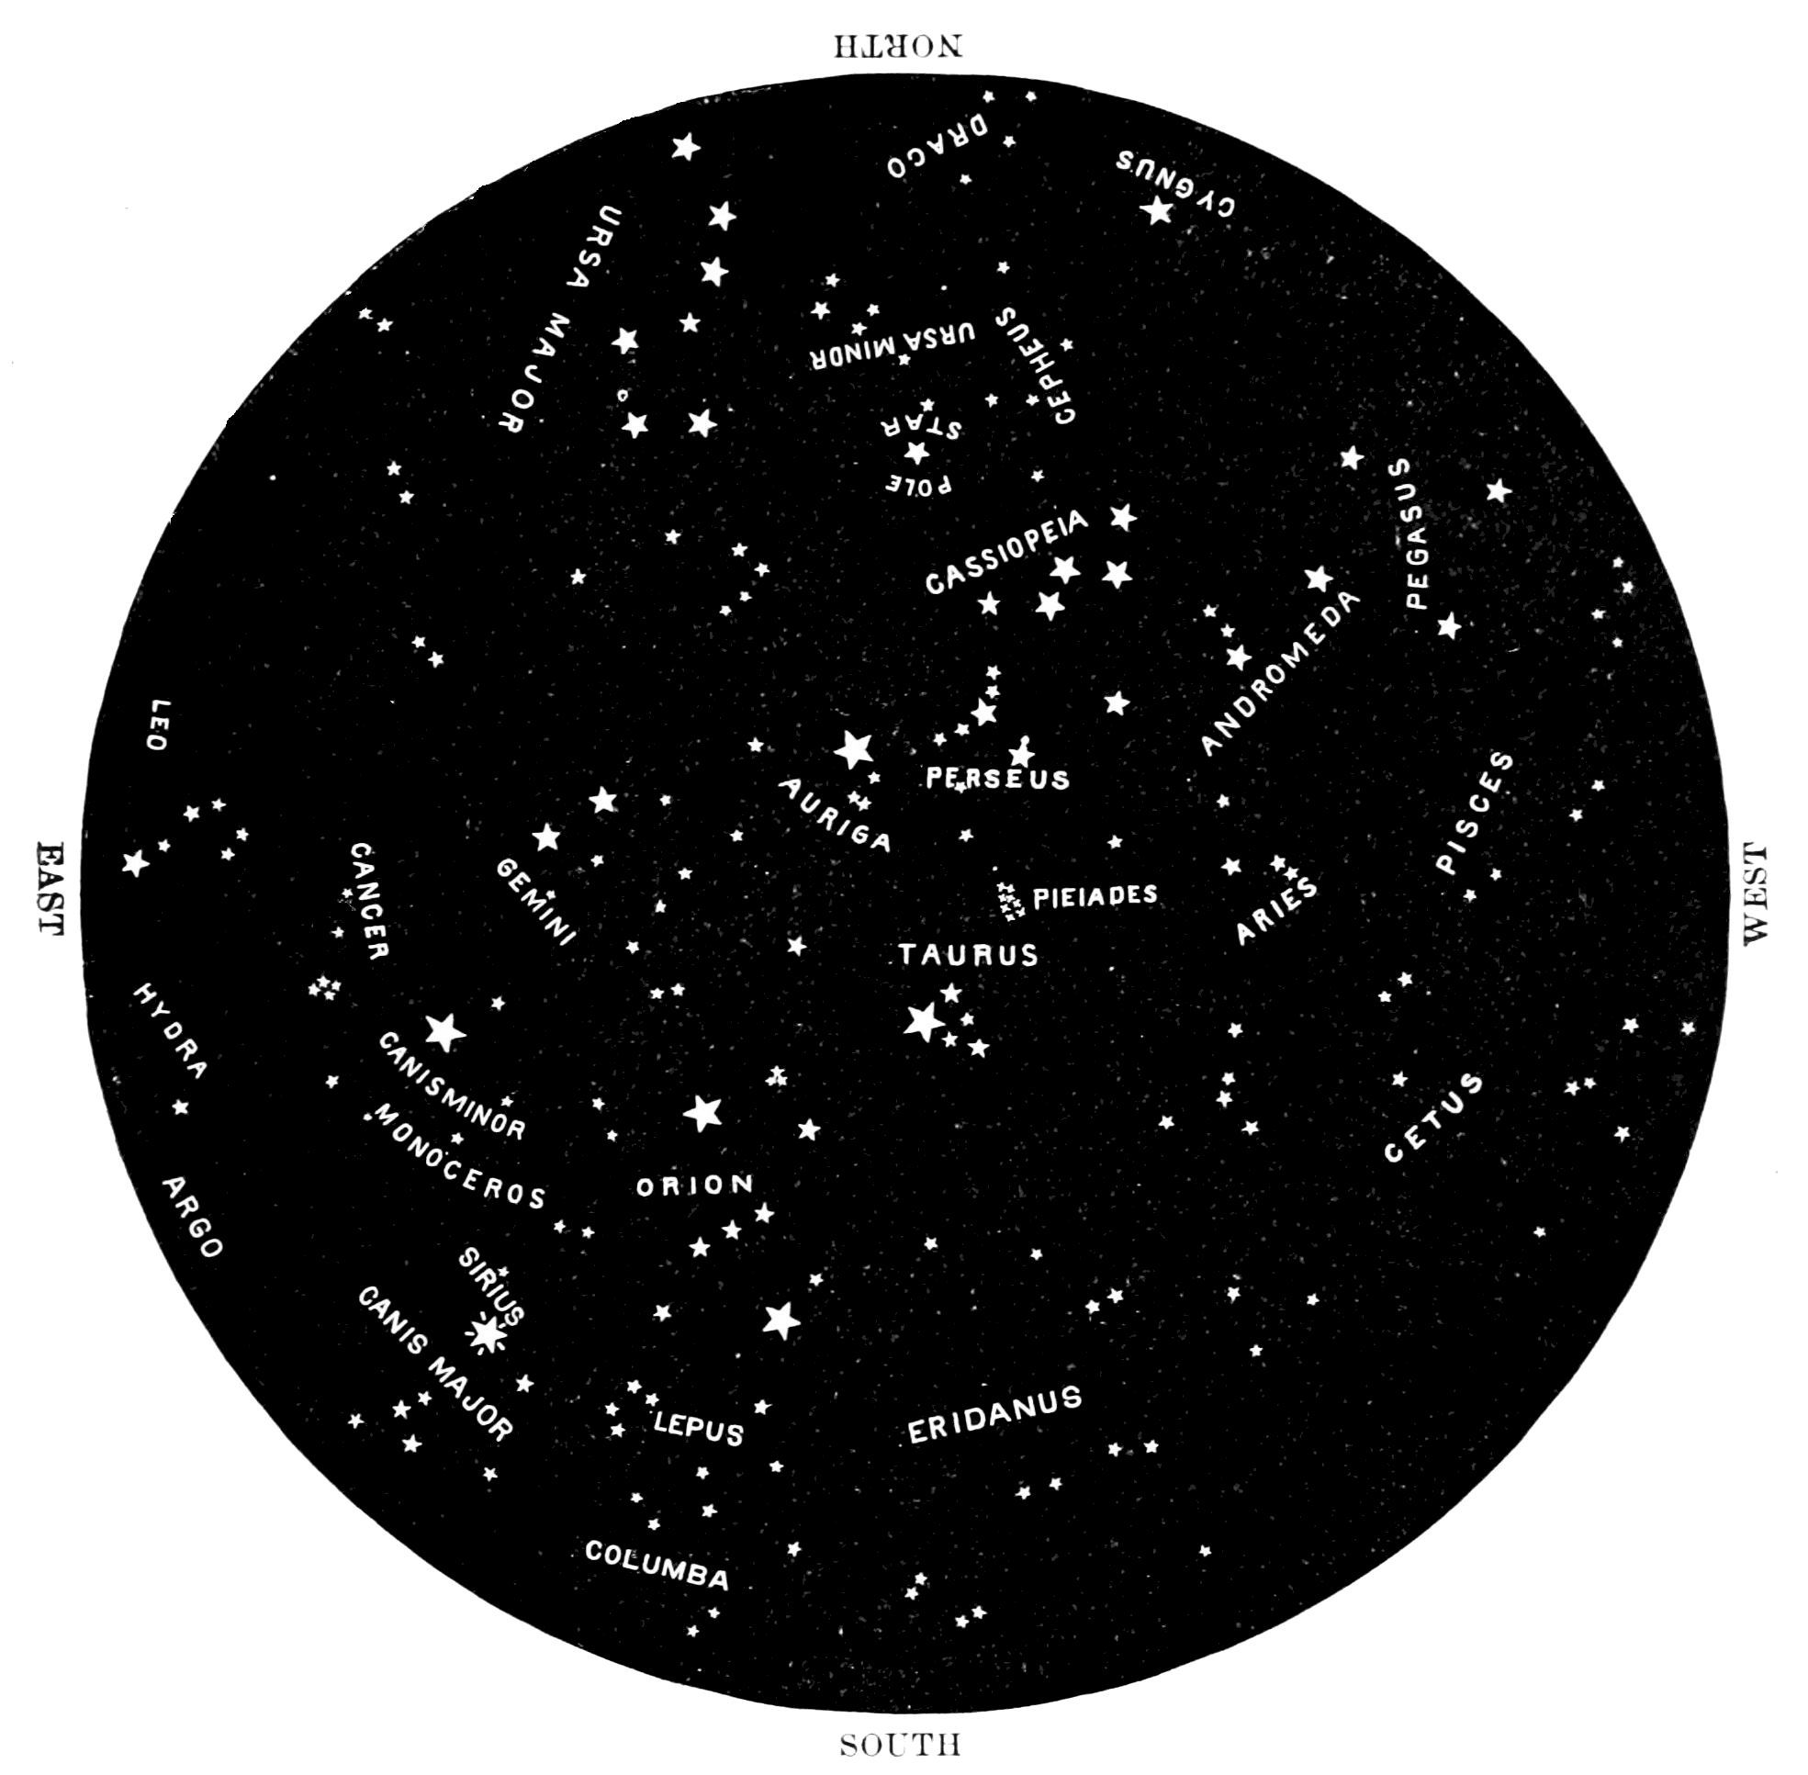
The heavens declare the glory of God; the skies proclaim the work of His Hands. Psalms 19:1

Slide 12
God alone stretches out the heavens…He is the Maker of the Bear and Orion, the Pleiades and the constellations of the south. Job 9:8-10

Slide 13
Tribe: Judah
Judah was the 4th son, of Jacob, with his wife Leah
Gen 29:35
Judah’s blessing from Jacob
Gen 49:8-12
Judah’s blessing from Moses
Deut 33:7

Slide 14
Tribe: Judah
Tribe of David
Tribe of Jerusalem
Tribe of Messiah
Judah became God’s Sanctuary Psalms 114
Symbol is the lion
Jesus is the Lion of the tribe of Judah
From the kingdom and tribe of Judah comes the name “Jew”

Slide 15
Tribe: Judah
Judah comes from the Hebrew word Yadah which means “to praise” “to give thanks” “to glorify” or “to acknowledge God”
Yadah, in turn, comes from the Hebrew word Yad, which means, “hand”
Yadah originally meant, “to extend the hand”
This gives the picture of the act of praising and worshiping God with lifting hands
Judah depicts an expression of praise
The hand symbolizes strength and power
When we lift our hands to the Lord, we are presenting to Him all of our strength and abilities (we are putting ourselves totally in His hands)

Slide 16
Tribe: Judah
Judah means PRAISE
The apostolic leadership, warring tribe, who knew
how to operate with sound.
This is a key time to PRAISE!!! (Judah goes first)
The month of thanking God for deliverance

Slide 17
Tribe: Judah
This is the time of spring when kings go out to war
(2 Sam. 10:1)
Even in a season of peace, you must discern what could
encroach on your boundaries and war what is rightfully
yours.
This is a season when you war for you covenant promises.
DO NOT HESITATE to loose a sound of praise that will break
you into a dimension of victory and wholeness.
Declare, in and by faith, that the power of the Blood of Jesus has
set you free.
Your path of healing and miracles are now before you!

Slide 18
Tribe: Judah
Judah is the king (the "first") of the tribes of Israel. His name means to give thanks, in speech (the sense of Nissan). The king rules his people by the power of his speech, an idea found in the verse, "For the king's word is his sovereign power." The month of Nissan is "the new year for kings"

Slide 19
Sense: Speech
The sense of speech implies ones ability to express one's deepest feelings and insights. Therefore, conceptually, all forms of expression are referred to generically as "speech.“
If you are making negative confessions during Nissan, you will have trouble through the rest of the year.
Negative confession will take seed in you, instead of positive confessions grabbing the wind and changing your atmosphere into blessings.
Speak forth your thankfulness to God for your deliverance
Remember where you have come from
Thank God for delivering you out of the bondage of sin

Slide 20
Colors/Stones
Dark Red
Sky Blue
Garnet
Blue Topaz

Slide 21
PASSOVER
Jewish holiday and festival
Commemorates the Exodus story
Begins on the 15th day of the month of Nissan
Occurs in the spring, which is the time to clean house (physically and spiritually)
Every Jewish family searched their house and removed all leaven(impurities)
Physical housecleaning represented the necessary spiritual checkup-a major step in deliverance-which God established as the first element in His yearly cycle of feasts
Examine your heart and ask, “What do I need to be delivered of this year?”
Passover reminds us of God’s power to deliver the Israelites out of Egypt in the past, which as a remembrance, fills us with faith for the future

Slide 22
PASSOVER
Exodus 12:2-51
Exodus 13:1-16
Leviticus 23:4-11
1 Corinthians 5:6-8

