Slide 1
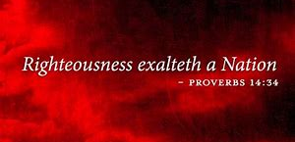
RAISING RIGHTEOUSNESS
THE 70 DAY DECREE

Slide 2
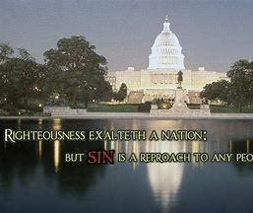
GOD IS THE ONLY ONE WHO CAN MAKE AMERICA GREAT…

Slide 3
REVIVAL
Revival occurs when the spiritual fervor and practice of members of an existing body of believers is re-kindling as a result of the Holy Spirit of God renewing their prior faith which had grown cold and renewing their foundation on the word of God.

Slide 4
AWAKENING
Awakening is an evangelical outpouring of the Spirit of God over a short period of time in which many who were non-believers become believers founded on the word of God in the Bible. The new believers are then enfolded into existing bodies of believers for growing in their knowledge of God and relation with God.

Slide 5
REFORMATION
Reformation is a re-alignment of beliefs and religious practices to be conformed to the word of God by throwing off beliefs and religious practices that are not in conformity with the word of God. Reformations change people’s beliefs, attitudes and actions. Those changes overflow to change church beliefs and practices, society (culture) and governments.

Slide 6
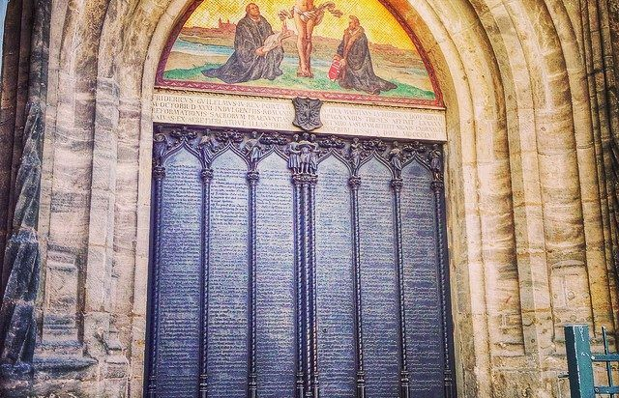
RAISING RIGHTEOUSNESS

Slide 7
REFORMATION

Slide 9
PROTESTANT REFORMATION: THE FIVE SOLAS
Sola Scriptura (“Scripture alone”): The Bible alone is our highest authority.
Sola Fide (“faith alone”): We are saved through faith alone in Jesus Christ.
Sola Gratia (“grace alone”): We are saved by the grace of God alone.
Solus Christus (“Christ alone”): Jesus Christ alone is our Lord, Savior, and King.
Soli Deo Gloria (“to the glory of God alone”): We live for the glory of God alone.

Slide 11
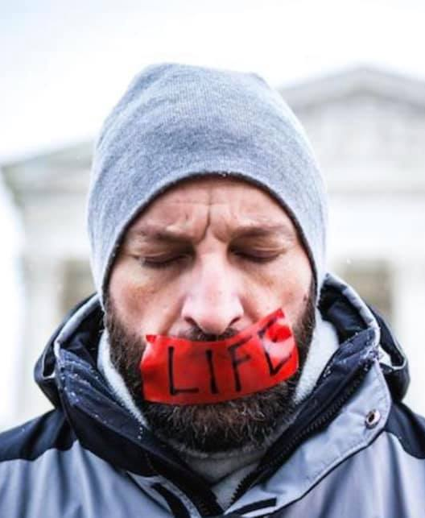
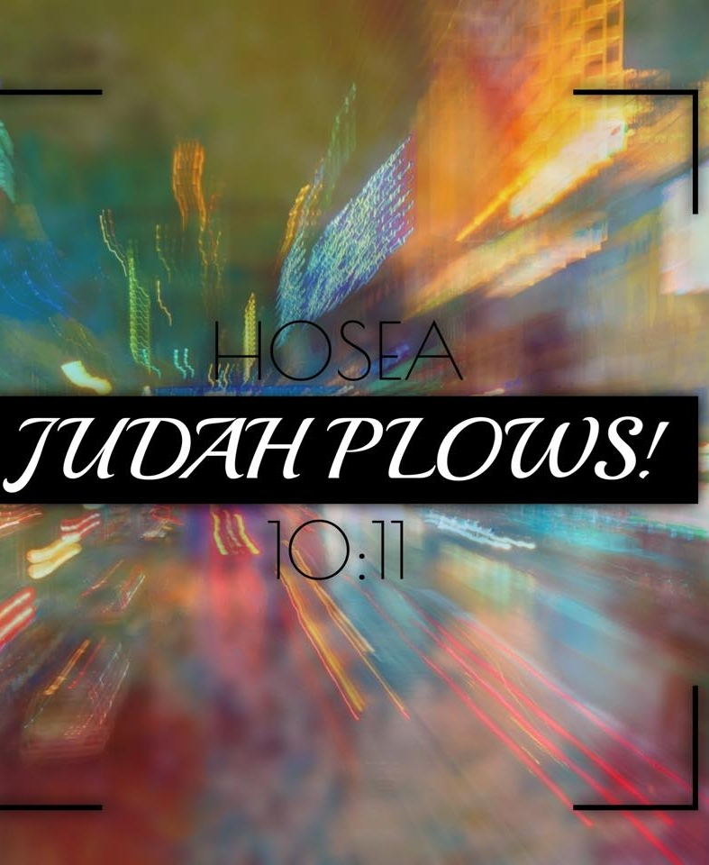
DECREE RIGHTEOUSNESS

Slide 12
RIGHTEOUSNESS EXALTS A NATION!
JUDAH IS PLOWING AND THE JOSIAH’S ARE RISING TO BRING REFORMATION IN OUR LAND!!! EMBRACE IT: JOSIAH REFORMERS! JOSIAH COMPANY! JOSIAH GENERATION! THE JOSIAH ANOINTING!
2 Kings 22:1-2 VOICE Josiah was 8 years old when he inherited the throne. His reign in Jerusalem lasted 31 years. His mother was Jedidah (daughter of Adaiah from Bozkath). Josiah was righteous in the Eternal’s eyes. He continually did what was right, just as his ancestor David had. He did not ever step away from the righteous path.

Slide 15
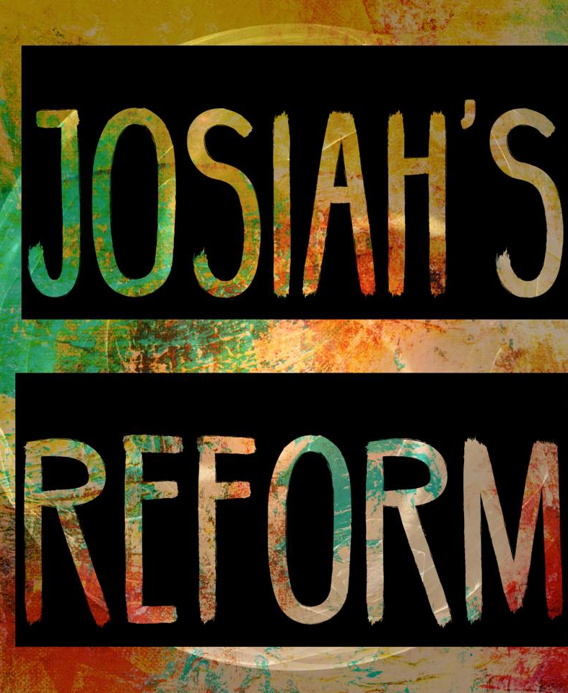
RAISING RIGHTEOUSNESS
THE 70 DAY DECREE

Slide 16
DECREE RIGHTEOUSNESS

Slide 17
RAISING RIGHTEOUSNESS
2/9/19 – 4/19/19
THE 70 DAY DECREE

