Slide 1
VISION
Mahanaim
Strongs H4264 machăneh, makh-an-eh'; from H2583; an encampment (of travellers or troops); hence, an army, whether literal (of soldiers) or figurative (of dancers, angels, cattle, locusts, stars; or even the sacred courts):—army, band, battle, camp, company, drove, host, tents.
The KJV translates Strong's H4264 in the following manner: camp (136x), host (61x), company (6x), tents (5x), armies (4x), bands (2x), battle (1x), drove (1x).

Slide 2
Sos 6:13-7:1(mahanaim)
SoS 6:v4,v10 awesome as army with banners(stars in procession niv)
v4 nasb You are as beautiful as Tirzah, my darling, as lovely as Jerusalem,as majestic as troops with banners.
(nlt) army with billowing banners.
v5 Turn your eyes from me; they overwhelm me.
v10 nasb Who is this that grows like the dawn, As beautiful as the full moon, As pure as the sun, As awesome as an army with banners?
v10 tpt Look at you now—arising as the dayspring of the dawn, fair as the shining moon. Bright and brilliant as the sun in all its strength. Astonishing to behold as a majestic army waving banners of victory.
v10 niv Who is this that appears like the dawn, fair as the moon, bright as the sun, majestic as the stars in procession?

Slide 3
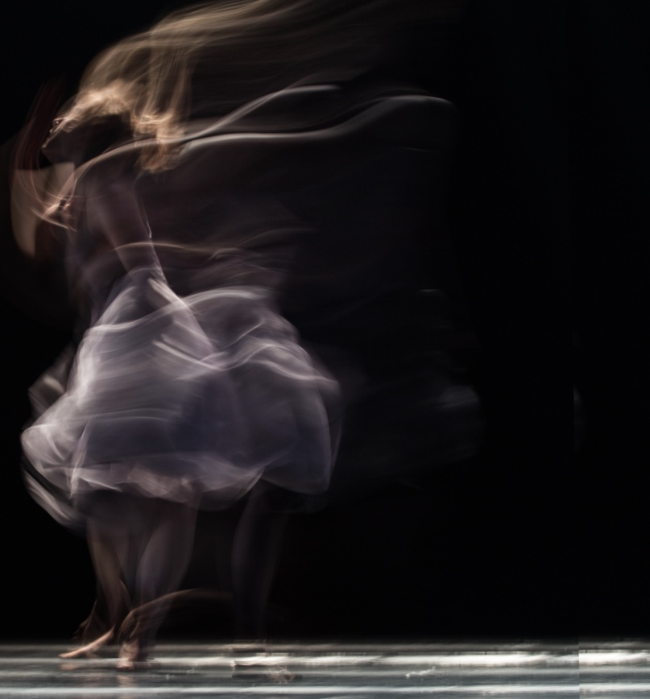
How does the Lord use our praise and movement as a weapon?
Isaiah 30:32 nasb And every [a]blow of the [b](A)rod of punishment, Which the Lord will lay on him,
Will be with the music of (B)tambourines and lyres; And in battles, (C)brandishing weapons, He will fight them.
In Isaiah 30 God has just told them about punishment for being rebellious but that He would come again and take care of their adversaries.
ps 149: 5-9
Let the godly ones exult in glory;Let them sing for joy on their beds. Let the high praises of God be in their mouth ( throat), And a two-edged sword in their hand,To execute vengeance on the nations And punishment on the peoples,To bind their kings with chains And their nobles with fetters of iron.

Slide 4
God’s Mobile Throne
Ez 1: 17-21 talks about the wheels that move he throne of GOD and how Ezekiel was seeing this and all that was moving up and out of the land.
In 10:6-19 Ezekiel saw a “man” go into the wheel and get fire from inside the wheels
Daniel 7:9-14 Daniel saw “burning fire wheels” and a “river of fire” coming forth from them.
Bill Johnson from Bethel says “our praise makes a landing strip for God’s presence and throne.”
Psalm 22: 3-4 You are holy, O You who are enthroned upon the praises of Israel, In You are fathers trusted; they trusted and You delivered them.
The story of Jehoshaphat is an example of that as well.

Slide 5
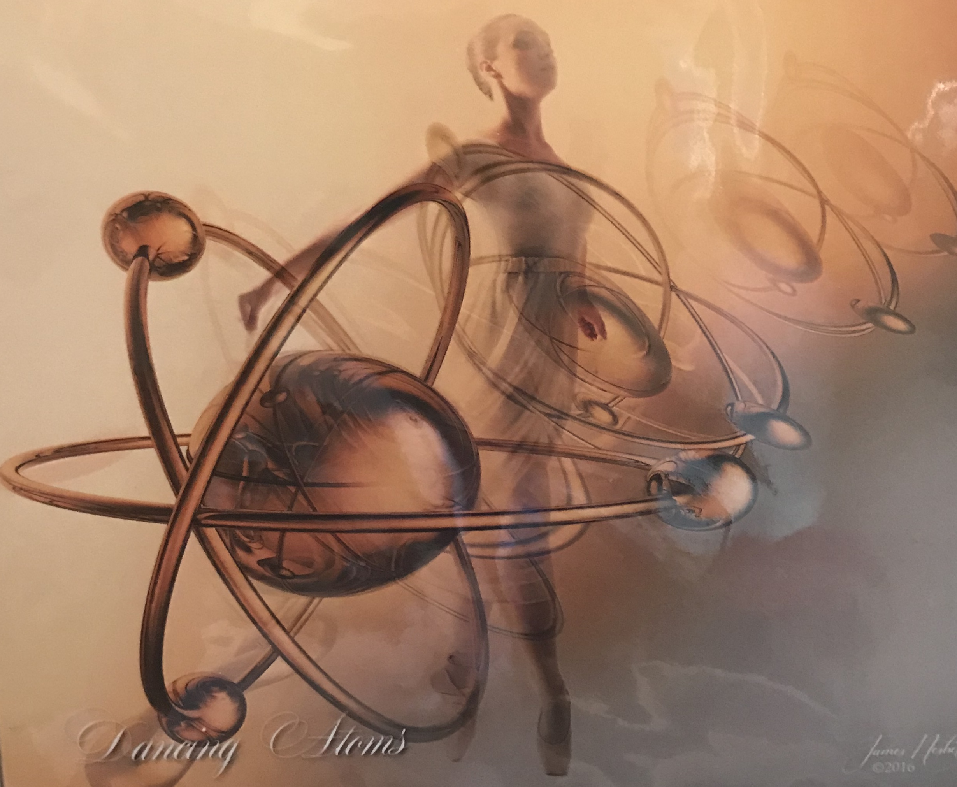

Slide 6

How do we move to release in the land?
What does God want released in the land?
What is our own movement DNA? We can ask GOD to reveal that to us.
The land has a voice and it knows our voice. We have seen example of that with words spoken over plants while their growth was measured.
Oaxaca Mexico has a festival each year where every that celebrates the dances of each area of Oaxaca and their native dress
Indigenous People Groups in our land in the Dakotas
Fiji/Maori people and their facial expression

Slide 7
II. Flow and Protocol
We saw the flow of GoZ service and how it looked like it was spontaneous but it had built in guidelines that the public eyes don’t see.

Slide 8
Leadership
Always defer to the leadership of the house. It is important to gain the trust of leadership. Movement in worship is a new thing in some places ad we must walk in humility and honor deferring to the leader. If they tell you to sit down, do it because there is some reason that you may or may not know about. (Vincent)
If something is going on that you are not unsure about, go to someone in leadership and let them know. Don’t try to take it on yourself. my motto is ‘unless you see blood or something is on fire don’t try and take it on’ just come and let me or someone in leadership know. I am talking about a strange manifestation in dance like writhing like a snake on the floor, or sexual movement that is inappropriate.(Bethel)
Sometimes things that look strange can be deliverance from something, like sobbing or lying on the floor. Sometimes people need to be left alone. I ask the Lord what is going on and He is faithful to reveal. If someone is crying cleansing tears they need to be alone with God and not my distractions. (Hope)

Slide 9
Worship Team Leader
worship team or leader : worship movement is also under the leadership of the worship leader. They know what the Lord is saying to them and what I am doing needs to sync up with that. The Holy Spirit doesn’t interrupt Himself. That doesn’t mean that the head is always right and you are not, but when in conflict, wait… our goal is for the Kingdom to come and be manifest not our agenda.
percussion instruments(tambourines) are not advised unless you are invited to do that and have gained the trust of leadership to use them. when hit a percussion instrument, you may be on the beat but the sound is released a mili-second later and if you are not able to anticipate that, it throws others off. (QB)

Slide 10
Anointing
Anointing: step back and see what is going on and where spirit is moving; what is “manifesting”; t is easy to get caught up in the moment or movement and we need to listen or pay attention both for personal and corporate reasons. God may want to move in a different way or speak to you personally about something. (Bill&Beni intercession)
different types of anointing that people carry in movement : standard bearers/gate keepers (paul); worship dancers (Vincent/Elaine);
anyone in the congregation: the Lord may be telling them to get out and move. That is acceptable and we want to see that happen. They may need to be delivered of something, or run, or pull off chains or ‘grave clothes’… that is a type of movement we will see in worship where movement is allowed. Deliverance and healing comes that way.
children’s movement : what they are releasing is important and vital in movement just like in their art. they usually pick up on what is in the atmosphere more readily than we do, so I really watch what they are doing in the back. (Lake Providence)

Slide 11
Visitors
If we have guest speakers, I will ask Betty what the protocol is if they are coming in to our house. When there are a lot of people we have to be aware of our space and not move in a way that will distract from visitors’ worship. I always hold back until I get the ok just to honor whomever is in charge. I wait for the invitation.
If people are coming in as visitors, they are always free to worship with our equipment and I make sure to let them know that if they are curious about our worship tools. Some people really get set free from things while using them .

Slide 12
Going into other spaces
When we go out to another place my protocol I also check with leadership to get a feel for how they see the meeting or the person in charge of the meeting. Alway get the invitation of the house.
We need to know timing and atmosphere and be aware. I heard a lady speaking that said we can’t grow rose in winter no matter how much we speak to the bush!
We can’t feed an infant a steak, which means know the ones you are ministering to.
No one can dance at NYCB without the right technical training (Starkville)

Slide 13
III. practical etiquette
care
a lot of our flags are made of silk, handprinted and are not cheap. The poles are made of special materials so that they will not break easily and they are not cheap either. Some of them are dyed and the dye will run if wet, so make sure when using them to role them up and put them back in the container. That is a spot where we know the rain does not come down the walls and since no one can get to the building quickly and it starts to rain, we would not be able to get here to insure they are not getting wet, so if you could, try and put them back in that corner holder.
some of our flags our members have personally purchased and we want to honor that by taking care because they really belong to others even though they have been gracious to leave them here and have never mentioned that, I am mentioning it because I am grateful they have done it so please take that in to consideration too.
sometimes people from outside will want to purchase or take home something we have and I always encourage them to take a picture of it and I have resources they can order from.

Slide 14
etiquette
other’s worship tools: when people bring their own tools with them, always get permission to use them. Betty will tell a story later about a lady who considered her tools weapons and did not want people to touch them so that is something to be considerate about.
Please don’t swap out poles without asking. Some of the poles are expensive and belong specifically for the flag they are on, so ask before disassembling.folding
putting (back in area because of rain leaks)
folding

Slide 15
dress
We have to be mindful of what we wear when we move both male and female. We have to be aware that we are close to people during worship. It is different from being on a stage. We don’t know what people are struggling with and we want to be modest. I think this is a no brainer to most of us but we want to bring Kingdom and not distraction.
Our house is free and it isn’t going to be a big deal if it happens, but we need to be mindful. (lady on stage)
I have a person in the congregation that lets me know if I have a wardrobe malfunction and need to re-adjust.

Slide 16
Future
celebration the Hebrew feasts.
the Jewish people are people of dance, really every culture has a native dance. 3 postures David used were: kneeling, lying prostrate, standing. you never turned your back on a king; hands open (supine), hands facing out; wave offerings, Jewish has been handed down and has stayed the same. These are fun classes to do and good exercises. They are living and I really get blessed and hear from the Lord when I participate.
Workshops for children and adults; dancers of all levels, from worship movers to professional level dancers. God has blessed be to know many professional dancers from all over the world. God is really moving in this and it is time to make a foundation to step into it.
eventually a training school
children park outreach in the park and making a streamer, small flag or worship instrument of some sort, having face painting, hotdogs, teaching memory movement verses to children. When you reach out to people’s kids you win the hearts of the parents. I have seen it done with gang members in Chicago.
I want to encourage you to experiment with movement in your prayer time and if He gives you a movement ask Him for the interpretation. He will tell you. It is your own movement style. (merce Cunningham… ex of choreo)

Slide 18
We will have a Movement in Worship class Saturday if you are interested in knowing more and becoming more involved.
We will begin with a teaching on the vision for MC Dance both corporately and individually and we will discuss dance technique and creative worship flow in spontaneous movement working in conjunction with the congregation and leadership of the house.
We will have a full dance class that morning that will consist of technique, center work, choreography, spontaneous worship exercises, and soaking/devotion exercises.
We will break for lunch from 11-1 and you may bring a lunch or pick something up during that time.
We will cone together again at 1 and discuss/experiment with different worship tools such as flags, banners, streamers, billows, mattehs, tambourines and possibly put a work together with those if time permits. we will also have a short teaching on these.
Please wear something that you can move in that feels comfortable. You may bring dance shoes if you have any but they are not necessary. We can dance barefoot. Also, bring a water bottle and a towel for any floor work we will do.
Please give e your e mail and phone number and we will begin a connection group list even if you are unable to come or just want to be in the loop of what is going on. Eventually i hope to be able to practice with the worship team to get a flow going with them if that is interesting to you.

