Slide 1
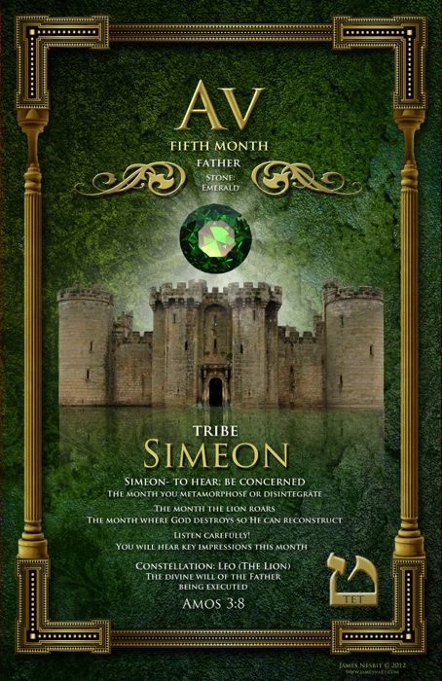
Psalm 139:16 your eyes saw my unformed body. All the days ordained for me were written in your book before one of them came to be. Hebrews 10:7 “Then I said, ‘Behold, I have come To do Your will, O God— To fulfill what is written of Me in the scroll of the book.’”
AV: FATHER, WILL, DESIRE

Slide 2
Joel 3:16 The Lord will roar from Zion and thunder from Jerusalem; the earth and the sky will tremble. But the Lord will be a refuge for his people, a stronghold for the people of Israel. NIV
HEBRAIC MONTH OF AV

Slide 3
THE MONTH THE LION ROARS!
Amos 3:7-8 7 Surely the Sovereign Lord does nothing without revealing his plan to his servants the prophets. 8 The lion has roared — who will not fear? The Sovereign Lord has spoken — who can but prophesy? NIV
This is probably one of your most incredible prophetic months. When the Lion roars and when the people of God roar, it creates a prophetic covering that will propel you into possession of your land and the promises of God

Slide 4
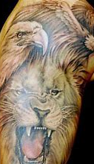
OUR FATHER…thy Kingdom come
It is the month of Sovereign happenings, divine will of Father taking place, and apostolic fathering.
Father God begins to execute and carry out things based on what we have responded to. The Lion of Judah is roaring for us (Joel 3:16). We must “roar” in faith. Our roaring/praise becomes a covering of the Lord, and God begins to unlock things for us. Let this be a month of joyful, powerful praise.
2 Corinthians 6:18 "I will be a Father to you, and you will be my sons and daughters, says the Lord Almighty."

Slide 5
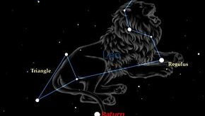
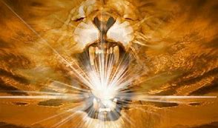
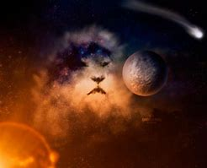
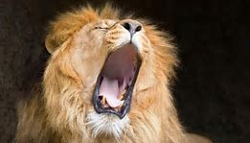
The Star Cluster: LEO THE LION
Av is the month of the constellation of the Lion.
Psalm 19:2 states the heavens declare the glory of God.

Slide 6
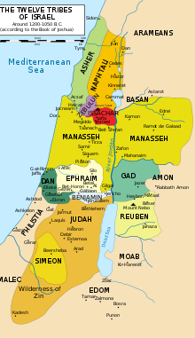
The Tribe of the month is Simeon
(To Hear): to be concerned; time of rectification of Hearing.
Simeon is the only Tribe that inherited land within another tribe. Simeon inherited its land within the land of the Tribe of Judah.
There is a prophetic picture here: Out of the midst of your praise (Judah) comes (Simeon) hearing. “Faith cometh by hearing; hearing the Word.”
The prophetic (the heart, mind and council of God) Word of God will come to you in the midst of your praise…the roar…will cause the prophetic word to spring forth which will set the course for your future.

Slide 7
The Sense: Hearing
Proverbs 20:12 Ears that hear and eyes that see — the Lord has made them both.
Matthew 11:15 He who has ears, let him hear. NIV

Slide 8
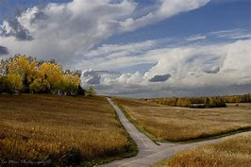
THE CROSSROADS…
Decide what you have heard and if you will heed it.
The month that you decide on what you have heard. You need to make a decision. “Will I just hear what God has told me, or will I actually do it?”
Jeremiah 6:16-17 This is what the Lord says: “Stand at the crossroads and look; ask for the ancient paths, ask where the good way is, and walk in it, and you will find rest for your souls. But you said, ‘We will not walk in it.’ 17 I appointed watchmen over you and said, ‘Listen to the sound of the trumpet!’ But you said, ‘We will not listen.’ NIV

Slide 9
BEWARE OF THE INQUITOUS ROOT!
Genesis 49:5-7 “Simeon and Levi are brothers — their swords are weapons of violence. 6 Let me not enter their council, let me not join their assembly, for they have killed men in their anger and hamstrung oxen as they pleased. 7 Cursed be their anger, so fierce, and their fury, so cruel! I will scatter them in Jacob and disperse them in Israel.
Simeon messed up, just like Reuben who was unstable. He was called an “instrument of cruelty” (Gen. 49:5). We are grafted into the great inheritance God has for us. However, when there is instability in the bloodline, we need to develop spiritual discipline—demons will try to convince you to align with and to agree with them. (For example, “I guess I am just weak,” or, “Hot tempered is just how I am.”)
The enemy understands how to use our iniquitous patterns to pull us back. When we agree with Satan’s iniquitous plan, it gets rooted in us.
We want to be concerned that we are able to continue moving ahead.
Hebrews 12:15 See to it that no one misses the grace of God and that no bitter root grows up to cause trouble and defile many

Slide 10
The month of Av is the lowest point historically on the Hebraic calendar.
It was during the month of Av that both temples were destroyed on the 9th. Same day, only years apart!
It is also the time of the year that the 12 spies were sent into the Promised Land to scope it out. There were 10 spies that came back with an evil report – totally disregarding what God had said (Num 13:32). As a result, Israel wandered in the Wilderness another 40 years. Joshua and Caleb were the only two that held to the Word of God. They believed and confessed, “We are well able to take this land.” These men were the only 2 of their generation who ultimately entered in to take possession of the land! Whose report will we believe and confess! It is time to enter into our promises!

Slide 11
Av is the month where God destroys so that He can reconstruct.
Ask the Lord to destroy the old foundations and structures that are hindering you and the moves of God from advancing.
Jeremiah 1:4-12 The word of the Lord came to me, saying, 5 “Before I formed you in the womb I knew you, before you were born I set you apart; I appointed you as a prophet to the nations.” 6 “Ah, Sovereign Lord,” I said, “I do not know how to speak; I am only a child.” 7 But the Lord said to me, “Do not say, ‘I am only a child.’ You must go to everyone I send you to and say whatever I command you. 8 Do not be afraid of them, for I am with you and will rescue you,” declares the Lord. 9 Then the Lord reached out his hand and touched my mouth and said to me, “Now, I have put my words in your mouth. 10 See, today I appoint you over nations and kingdoms to uproot and tear down, to destroy and overthrow, to build and to plant.” 11 The word of the Lord came to me: “What do you see, Jeremiah?” “I see the branch of an almond tree,” I replied. 12 The Lord said to me, “You have seen correctly, for I am watching to see that my word is fulfilled.” NIV

Slide 12
TODAY IF YOUR HEAR HIS VOICE…
James 1:22-25 Do not merely listen to the word, and so deceive yourselves. Do what it says. 23 Anyone who listens to the word but does not do what it says is like a man who looks at his face in a mirror 24 and, after looking at himself, goes away and immediately forgets what he looks like. 25 But the man who looks intently into the perfect law that gives freedom, and continues to do this, not forgetting what he has heard, but doing it — he will be blessed in what he does. NIV
Hebrews 4:7 Therefore God again set a certain day, calling it Today, when a long time later he spoke through David, as was said before: "Today, if you hear his voice, do not harden your hearts." NIV

Slide 13
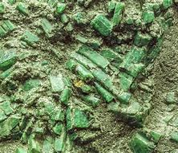
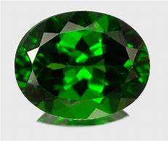
The Stone of the month is the Sapphire
The Sapphire: means to discern, hear.
The description is Riches, to count, to multiply.
The negative is counting and desiring money instead of focusing on Yahweh. Remember that God is your source.
This is a time that Father God wants to bring increase and multiplication into your life. He is ready to bring you into your inheritance and your land that is flowing with milk and honey! Don’t get distracted by money.
Watch the spirit of greed and mammon. You can’t serve God and mammon!

Slide 14
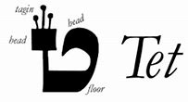
The Alphabet of the month is Tet
It resembles the womb. Certain things will be conceived and given birth to this month.
The image of tet is the coiling of a serpent. It represents potential power!
You have a choice to give birth to the next cycle in your life, go to the next level, or like Simeon you can choose to not hear.
This is the month where the earth contracts – the secret of the pregnancy begins to move into the earth realm. Watch for earthquakes. When you hear of earthquakes, know that God is getting ready to birth something.
There will be a shaking and toppling of ungodly structures in your life. Alignment is very important! Aligning with the intercession of heaven: Jesus is interceding! Holy Spirit is interceding in us through our spirit man! Creation is interceding- longing for your reveal!

Slide 15
Romans 8:18-28 18 That’s why I don’t think there’s any comparison between the present hard times and the coming good times. 19 The created world itself can hardly wait for what’s coming next. 20 Everything in creation is being more or less held back. God reins it in 21 until both creation and all the creatures are ready and can be released at the same moment into the glorious times ahead. Meanwhile, the joyful anticipation deepens. 22 All around us we observe a pregnant creation. The difficult times of pain throughout the world are simply birth pangs. But it’s not only around us; it’s within us. The Spirit of God is arousing us within. We’re also feeling the birth pangs. 23 These sterile and barren bodies of ours are yearning for full deliverance. 24 That is why waiting does not diminish us, any more than waiting diminishes a pregnant mother. We are enlarged in the waiting. We, of course, don’t see what is enlarging us. 25 But the longer we wait, the larger we become, and the more joyful our expectancy. 26 Meanwhile, the moment we get tired in the waiting, God’s Spirit is right alongside helping us along. If we don’t know how or what to pray, it doesn’t matter. He does our praying in and for us, making prayer out of our wordless sighs, our aching groans. 27 He knows us far better than we know ourselves, knows our pregnant condition, and keeps us present before God. 28 That’s why we can be so sure that every detail in our lives of love for God is worked into something good

Slide 16
Isaiah 1:18-20 18 “Come now, let us reason together,” says the Lord. “Though your sins are like scarlet, they shall be as white as snow; though they are red as crimson, they shall be like wool. 19 If you are willing and obedient, you will eat the best from the land; 20 but if you resist and rebel, you will be devoured by the sword.” For the mouth of the Lord has spoken.

Slide 17
Isaiah 66:9 Do I bring to the moment of birth and not give delivery?” says the Lord. “Do I close up the womb when I bring to delivery?” says your God.
Hebrews 3:7-8 So, as the Holy Spirit says: “Today, if you hear His voice, 8 do not harden your hearts NIV

Slide 18
The Organ of the month is the Left Kidney
The kidneys sift/filter blood.
They “discern” waste and separate it out.
The month of Av is a time for us to develop a new level of discernment.
By this time, spiritual kidneys should be working. We should be discerning & responding to our spiritual leader.
There should be no resistance to the leading of the Holy Spirit.

Slide 19
Psalm 16:7 I will bless the LORD, who hath given me counsel: my reins also instruct me in the night seasons. (King James Bible – Cambridge Ed.) I shall bless Lord Jehovah who counsels me and my kidneys teach me in the nights. (Aramaic Bible in Plain English (©2010)
Psalm 32:8 I will instruct you and teach you in the way you should go; I will counsel you with my loving eye on you. NIV

Slide 20
Av is the month you go through metamorphosis or disintegrate
In the midst of your test, you will come face to face with Him.
This is the month where the Kingdom advances through partnership!
It is the month of predestined connections. This means God has connections preordained for you that will manifest and will really help you to move ahead. Consider that as we align ourselves with those God brings. Be very aware of your partnerships. Watch them. This is more than just connections. Be aware and supportive of the partnerships God has given you. When our alignment is correct our way will be easier.
Remember, that in praise you will be set at one with the Lion of the Tribe of Judah. Out of the midst of the roar will come the “now” Word of God for you to decree and declare: that you be established in your destiny and enter in to take possession of your land and the promises of God!

